Slide 1



product
product
product

Slide 2
Monotone Classification with Relative Approximations
Based on the paper by Yufei Tao (2026)
Presented by Ethan Leo Ming Quan, Balakrishnan Vaisiya, Atharshlakshmi Vijayakumar, Zhu Ke Xiong

Slide 3
Scenario:
Are these two listings referring to the same product?

Slide 4
Entity Matching
Given two sets of entities E₁ and E₂, determine for every pair (e₁, e₂) ∈ E₁ × E₂ whether they refer to the same real-world entity.
It is a binary classification task to determine if a pair is a match (+1) or non-match (-1).
product
product
product

Slide 5
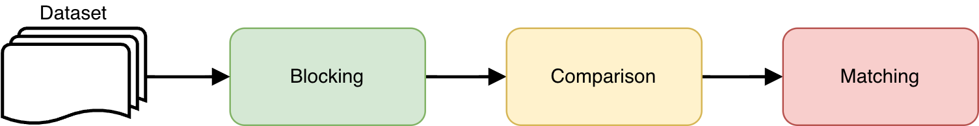
Entity Resolution Pipeline
Blocking: Narrow down the search space
Comparison: Quantify similarities between candidate pairs
Matching: Determine matching (+1) and non-matching (-1) pairs
This is the main focus of the paper

Slide 6
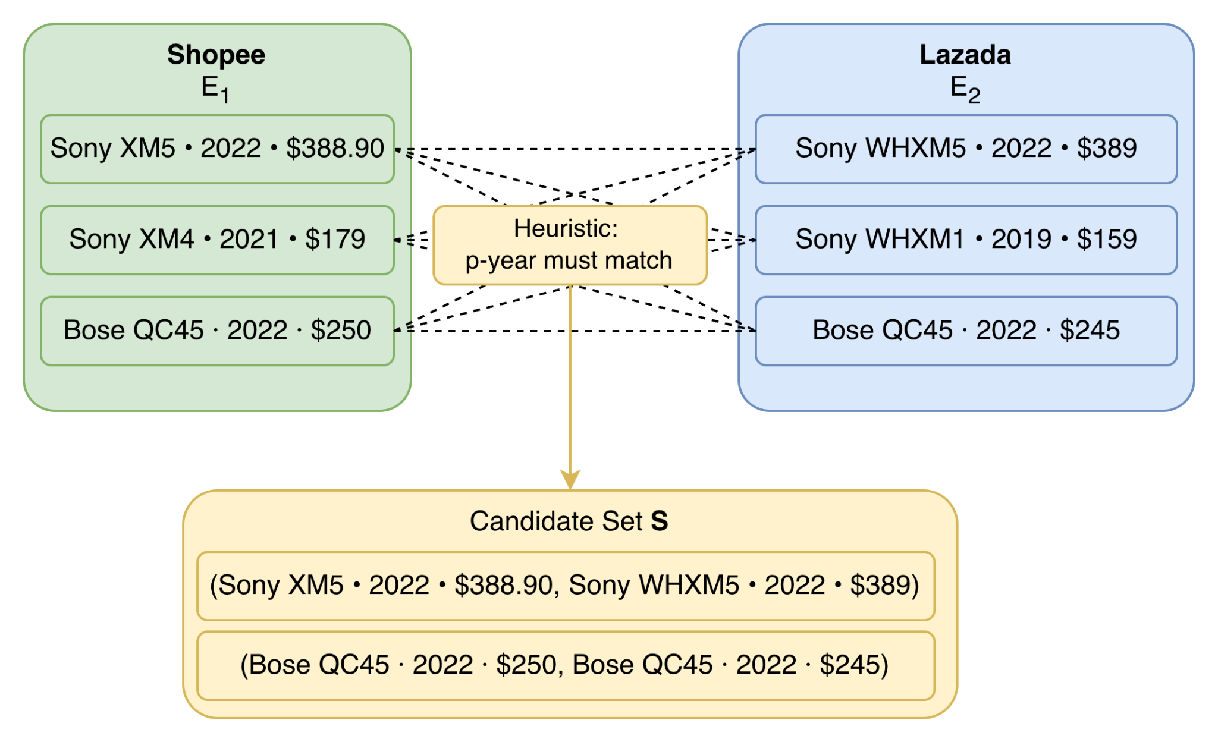
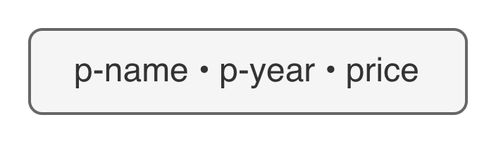
Blocking
Prune the set of possible pairs into a smaller subset of candidate pairs: S ⊆ E₁ ✕ E₂ using an application-dependent heuristic.
Locality Sensitive Hashing (LSH) can also be used for this step.
Consider each product with the following attributes:
Forming candidate pairs based on agreeing year which the product was released (p-year)

Slide 7
Comparison
For each candidate pair (e₁,e₂) ∈ S, quantify the similarity across d attributes using a set of predefined similarity functions sim₁, sim₂,...,sim_{d}.
Consider the first candidate pair (e₁,e₂) in S from earlier with attributes (p-name,p-year,price):
e₁ : (“Sony XM5”, 2022, $388.90)
e₂ : (“Sony WHXM5”, 2022, $389)
Apply similarity functions across each attribute:
p-name : Jaccard Distance -> sim₁(e₁.p-name, e₂p-name) = 0.8
p-year : Use exact match, return 1 if equal and 0 otherwise -> sim₂(e₁.p-year, e₂.p-year) = 1
price : Negated absolute difference -> sim₃(e₁, e₂) = - |e₁.price - e₂.price| = - 0.1
The resulting point representing this pair in ℝ³ is p_{e1, e2} = (0.8, 1, -0.1)

Slide 8

Matching
The comparison step produces a d-dimensional set of points P = {p_{e1,e2} | (e₁,e₂) ∈ S }
Each point carries a label, +1 if (e₁, e₂) is a match and -1 otherwise
But this label is hidden
Labelling is ultimately determined by a human expert
But with thousands of listings on e-commerce platforms, E₁ × E₂ grows quadratically
Labelling is expensive and torturous for a human being labour intensive

Slide 9
Monotone Classification
Classification with a monotonicity guarantee…. But what’s that?
Notes:
SLIDE 1 — Title
"Welcome to Section 2. We've spent Section 1 setting up the problem — we have a point set P in R^d, labels are hidden, and we want a monotone classifier with error at most (1+ε)k* using as few label queries as possible.
The algorithm we'll study first is called RPE — Random Probes with Elimination. It's deceptively simple. It requires no prior knowledge of k* or the width w. And yet it achieves a 2-approximate solution in expectation with provably low probing cost. It's the foundation everything else in the paper builds on."
SLIDE 2 — Core Idea
"The entire algorithm is just two steps, repeated in a loop.
Step 1: pick a random unlabelled point and ask the oracle for its label.
Step 2: use monotonicity to immediately assign labels to a whole region of the space — and remove those points. You don't need to probe them.
Then you repeat on what's left.
The key question is: why does step 2 work? Why can one probe determine the labels of many other points? That's what the next slide explains."
SLIDE 3 — The Dominance Cone
"This is the conceptual heart of the algorithm.
When we probe a point z and find its label, monotonicity gives us the labels of every point that's comparable to z — meaning every point that's either strictly above z or strictly below z in every feature simultaneously.
On the left: if label(z) = +1, then any point p that dominates z — meaning p is at least as large as z on every coordinate — must also be +1. Because if it were -1, that would violate monotonicity. So we can safely label all of them +1 and remove them.
On the right: if label(z) = -1, then any point p dominated by z — smaller or equal on every coordinate — must also be -1. Same reasoning. Remove them.
The shaded region in each diagram is the dominance cone of z — the set of points whose labels are forced. These can be very large, especially in high dimensions. That's what makes RPE efficient.
The critical point: only the points that are incomparable to z — neither above nor below it — remain uncertain. These are the points the algorithm still needs to probe."
SLIDE 4 — Pseudocode
"Here's the formal algorithm. It's short enough to fit on one slide.
Line 1: start with an empty set Z, which will hold all probed points. Lines 2–5: the main loop. Pick a random element z, probe it, add it to Z, then remove its dominance cone from P. Line 6: return Z.
From Z, we derive the classifier hRPE on the right. A point p gets label +1 if it dominates at least one confirmed positive in Z; otherwise it gets -1.
Two quick notes:
This classifier is always monotone. If p dominates q and hRPE(q)=1, then by transitivity p dominates the same positive witness z, so hRPE(p)=1 too. No contradiction possible.
Notice the footer: RPE never actually computes the width w. The width only appears when we analyze the algorithm's cost — it's invisible to the algorithm itself."
SLIDE 5 — Worked Example, Step 1
"Let's trace RPE on the 16-point set from Figure 1 of the paper. Green points are label +1, navy circles are label -1. The optimal error is k* = 3.
Suppose RPE randomly picks p₁ as its first probe. The oracle says label(p₁) = +1. So RPE must remove every point p that p₁ dominates, i.e., everything in the upper cone of p₁.
Look at where p₁ is: near the bottom-left of the feature space. That means it has low values on both features. Any point that has higher values on both features — which is most of the plot — is dominated by p₁... wait, no: p dominates p₁ means p has higher values. So p₁ being bottom-left means most other points dominate p₁. We remove all p ⪰ p₁.
The result: 13 out of 16 points are immediately eliminated in one probe. Only p₆, p₇, and p₈ remain — they're incomparable to p₁ because they lie below or to the side of it in feature space.
So after one probe: 13 points determined, 3 remain."
SLIDE 6 — Worked Example, Step 2
"Now RPE picks randomly from the 3 remaining points and hits p₈. The oracle says label(p₈) = -1. RPE removes every p ⪯ p₈ — points dominated by p₈. That eliminates p₆, p₇, and p₈ itself. P is now empty.
Final result: Z = {p₁, p₈}. Just 2 probes to handle all 16 points.
The classifier: everything dominating p₁ gets +1, everything else gets -1. The error turns out to be 5. Now, that's higher than k* = 3 — but is it within the 2k* = 6 guarantee? Yes. Five is less than six.
This is the expected trade-off: RPE probes very few points but may produce a somewhat suboptimal classifier. The guarantee tells us just how suboptimal it can be."
SLIDE 7 — Theorem 1
"Theorem 1 formalises what we just saw.
Error: the expected error of hRPE is at most 2k*. Note — this is in expectation. Any particular run might do better or worse.
Cost: RPE probes at most O(w · Log(n/w)) points in expectation. Log here is log₂(1+x), a slightly modified logarithm that behaves well near 0. For practical purposes, treat it as a standard log.
Two properties worth emphasising. First: no knowledge of k* required. Most active learning algorithms need ξ as a parameter, which requires knowing ν = k*/n. RPE doesn't. Second: the bound is in expectation. This will be addressed in Section 3."
SLIDE 8 — Error Proof Sketch
"How do we prove E[err] ≤ 2k*? The proof proceeds by induction on |P|.
The key step: fix any monotone classifier h. Partition P into h-good points (correctly classified by h) and h-bad points (misclassified). Setting h = h*, there are exactly k* bad points.
Lemma 2 says: the expected number of h*-good points that RPE misclassifies is at most k*. Add the k* bad points (which are always misclassified regardless), and total expected error ≤ 2k*.
The tool that makes Lemma 2 work is the symmetry of influence sets. For each bad point p, define Ibad(p) as the set of good points that would get misclassified if p were probed first. For each good point q, Igood(q) is the set of bad points that would get 'corrected' if q were probed first.
The key symmetry — Lemma 2.2 — is that these two quantities sum to the same total. The total 'error potential' from bad points equals the total 'correction potential' from good points. This balance is what allows the inductive argument to close at exactly errP(h)."
SLIDE 9 — Cost Proof Sketch
"The cost bound uses three ideas.
Step 1: By Dilworth's Theorem, any point set P can be partitioned into exactly w disjoint chains — where w is the dominance width. Every pair of points within a chain is comparable.
Step 2: Within any single chain of size m, RPE's probing behaviour can be modelled as an Attrition-and-Elimination game. An adversary Bob deletes points to make life hard; Alice picks random points and eliminates the upper portion. The key lemma: regardless of what Bob does, the game ends in O(log m) rounds in expectation. The proof: each round halves the chain with probability greater than ½, so you need at most O(log m) halvings.
Step 3: Sum the costs across all w chains. The total is O(Σ log|Cᵢ|). By Jensen's inequality, since log is concave, this sum is maximised when all chains are equal size n/w. That gives O(w · log(n/w)) = O(w · Log(n/w))."
SLIDE 10 — Factor 2 is Tight
"We've shown E[err] ≤ 2k*. Can we do better? Can we get, say, 1.5k* with RPE's random-probing strategy?
No. The factor of 2 is exactly tight. Here's the hard example.
Place n−1 points with label -1 and one point with label +1, arranged so no point dominates any other — width w = n. The optimal classifier maps everything to -1, giving k* = 1.
Now watch what RPE does. With probability 1/n, it probes the positive point first. Since that point dominates nothing, no elimination occurs, and all n−1 negative points remain — they all end up labelled +1. Error = n−1.
With probability 1 − 1/n, RPE probes a negative point first. It eliminates at most one point, and the final error is just 1.
Expected error = (1/n)·(n−1) + (1 − 1/n)·1 = 2 − 2/n → 2 as n → ∞.
Since k* = 1, the ratio approaches 2. The factor of 2 is asymptotically tight."
SLIDE 11 — Limitations
"RPE has two fundamental limitations, both of which motivate Section 3.
Limitation 1: the factor-of-2 is the best RPE can achieve. No tweak to the random-probing strategy changes this. If we want error (1+ε)k* for small ε — say ε = 0.01 — we need a completely different technique. That technique is the relative-comparison coreset.
Limitation 2: the guarantee is only in expectation. A single run could produce error much larger than 2k*. Section 3 provides a high-probability guarantee — w.h.p. the error is at most (1+ε)k*.
The comparison table shows the trade-off: the coreset algorithm achieves much stronger guarantees, but at a probing cost of O(w/ε² · log(n/w) · log n) — roughly a factor of log(n)/ε² more than RPE."
SLIDE 12 — Summary
"Let's recap the four things to remember from Section 2.
One: RPE is a simple parameter-free loop. Probe a random point, eliminate its dominance cone, repeat. No knowledge of k* or w needed.
Two: it's efficient. The expected probing cost is O(w · Log n/w), proved via chain decomposition and the A&E game.
Three: it's 2-approximate in expectation. E[err] ≤ 2k*, proved by induction using the symmetry of influence sets.
Four: the factor-2 is tight and the bound is in expectation only. Both limitations are what motivate Section 3's relative-comparison coreset approach.
In Section 3, we'll see how to extend RPE's ideas to achieve error (1+ε)k* with high probability, for any ε > 0 the user specifies."

Slide 10
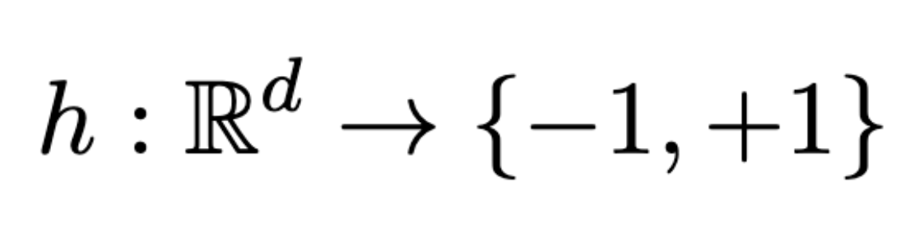
Monotone Classification
We define a classifier as a function:
Where the input is the set P of n points in ℝ^{d} for d ≥ 1
Each point p ∈ P has a label from {-1, 1} represented as label(p)
A correct classification of a point p ∈ P is if h(p) = label(p) and a misclassification otherwise
But what would be a suitable classifier?

Slide 11
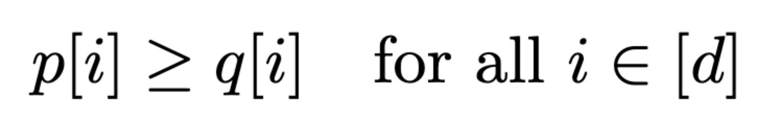
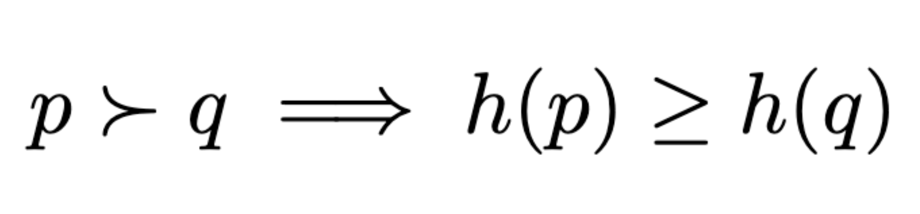
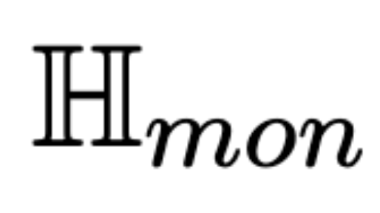
Monotone Classification
Dominance: A point p ∈ ℝ^{d} dominates another point q ∈ ℝ^{d} , denoted as p ≻ q if:
The Monotonicity Constraint
A classifier is said to be monotone if:
In other words, if pair p is as similar as q on every attribute, if a classifier h labels q as a match, then it should also label p as a match.
This is a key criteria for our classifier. We denote the set of monotone classifiers as

Slide 12
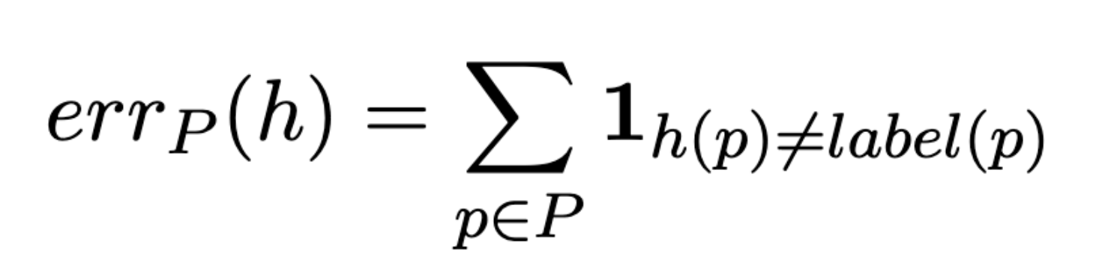
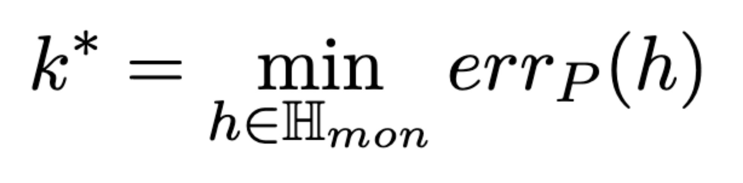
Monotone Classification
Optimal Monotone Error
Given a classifier h, its error is defined as the number of misclassifications it makes on P:
A classifier h ∈ H_{mon} is optimal on P if it attains the smallest possible error over all monotone classifiers. This is defined as the Optimal Monotone Error:

Slide 13
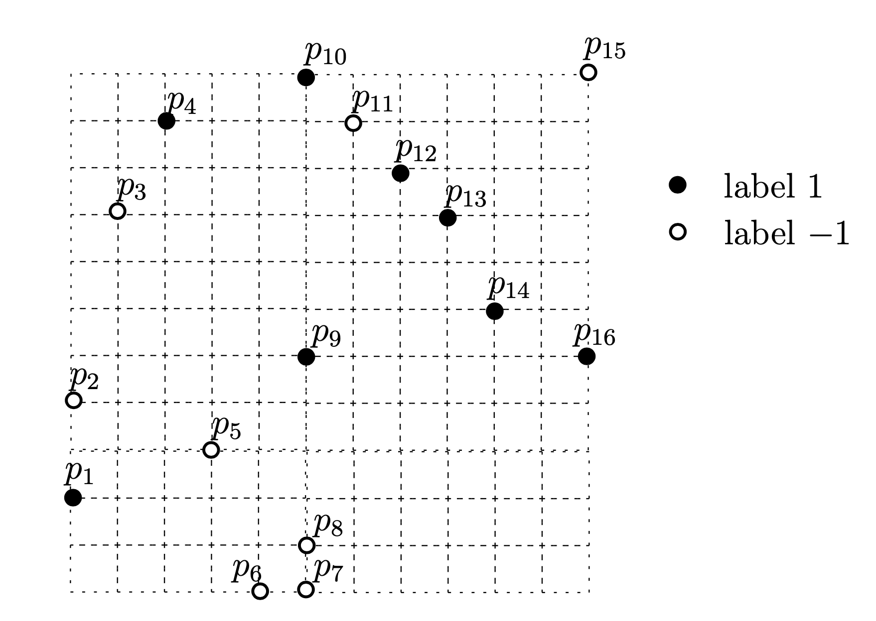
Example
The 2D grid illustrates an input set P.
Consider a monotone classifier h that:
Classifies all black points except p₁ to 1
Classifies all white points excep p₁₁ and p₁₅ to -1
err_{p}(h) = 3
Assuming no other monotone classifier has smaller error on P, k* = 3
Since k* > 0 here, this is considered as a non-realizable case.
Notes:
Because you are mentioning “non-realizable” case here without any prior background, you must explain it later to your audience either during activ

Slide 14
Finding an Optimal Monotone Classifier
We want an algorithm A to return h ∈ H_{mon} that has low error on P.
Labels are hidden from A at the start. So A asks an oracle (e.g. human expert) to reveal a point’s hidden label - this is a probe
Cost of A = total number of probes
Probing all of P guarantees finding optimal h but with n cost.
Probing nothing ensures zero cost but with poor classification results

Slide 15
Finding an Optimal Monotone Classifier
When k* = 0, this is the realizable case. There exists a classifier h ∈ H_{mon} that perfectly classifies P
When k* > 0, this is the non-realizable case. No classifier in H_{mon} classifies P without min k* error
We define ε ≥ 0 as a tolerance parameter to allow the returned classifier to exceed k* by a small multiplicative factor
Problem 1. Monotone Classification with Relative Precision Guarantees
Given a real value ε ≥ 0, find a monotone classifier h ∈ H_{mon} whose error on P is at most (1+ε)•k*, while minimizing the number of probes made by A.

Slide 16
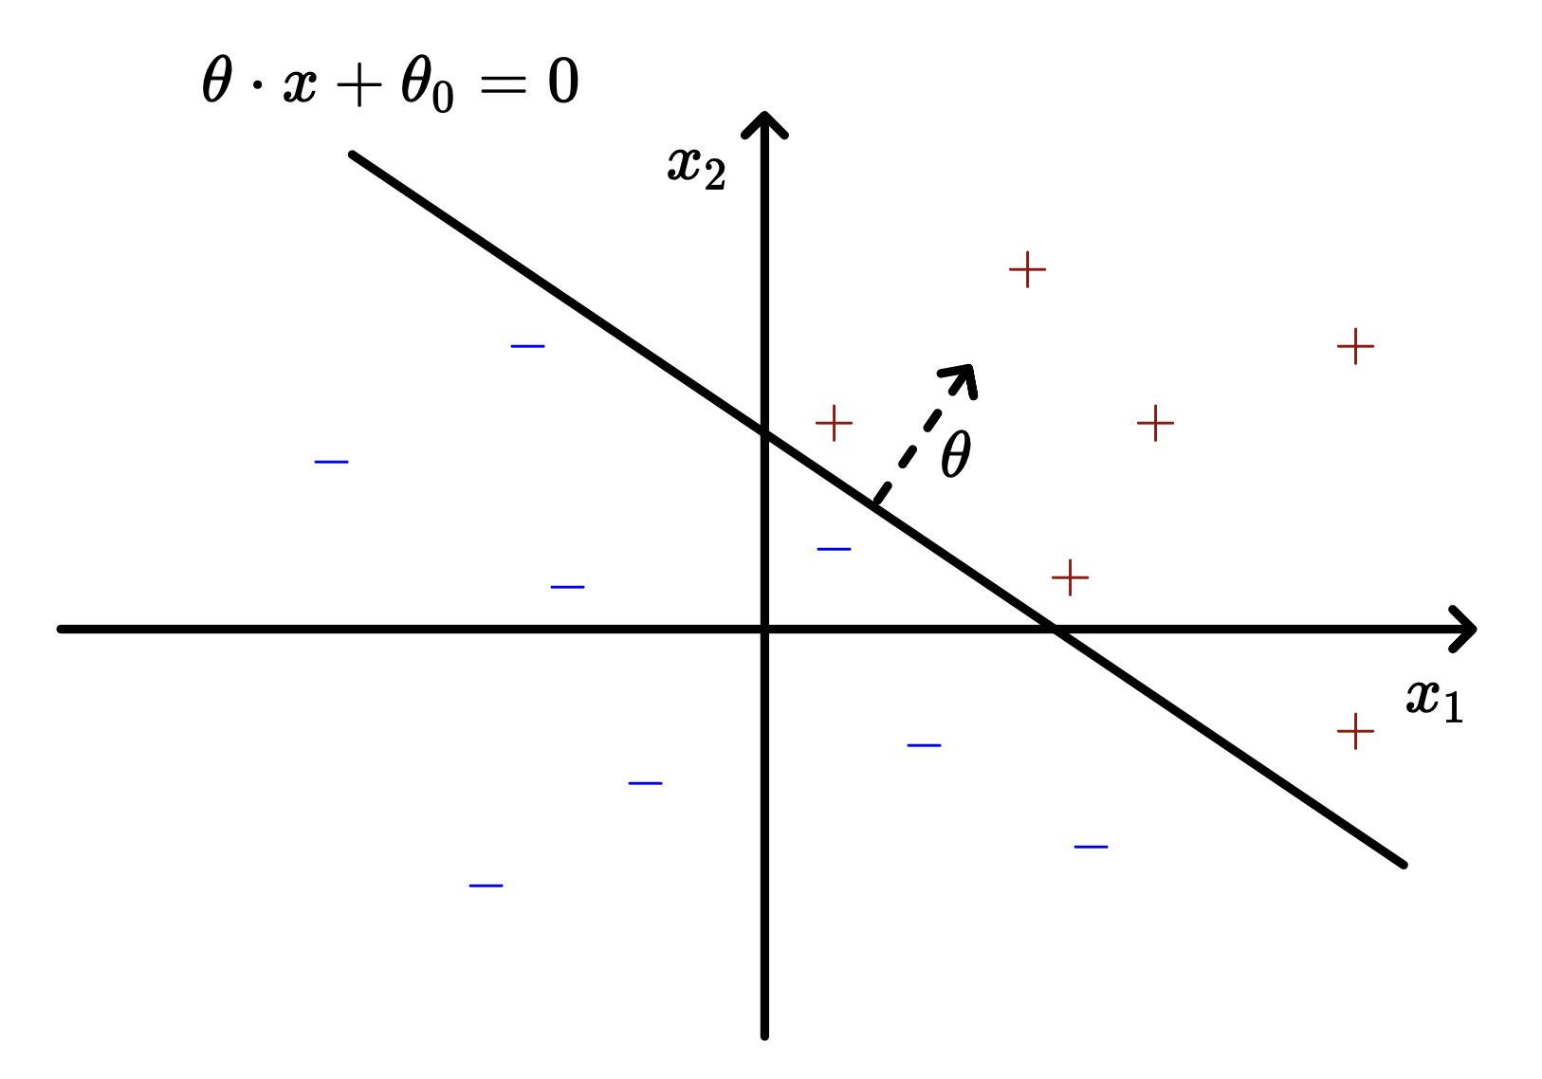
Analogy to the realizable case
Recall from SC2300 on Linear Classification:
The realizable case is when the training dataset S_{n} = {(x^{(t)}, y^{(t)}), t =1,...,n} is linearly separable, the perceptron algorithm can find parameters θ and θ₀ to attain zero training error.

Slide 17
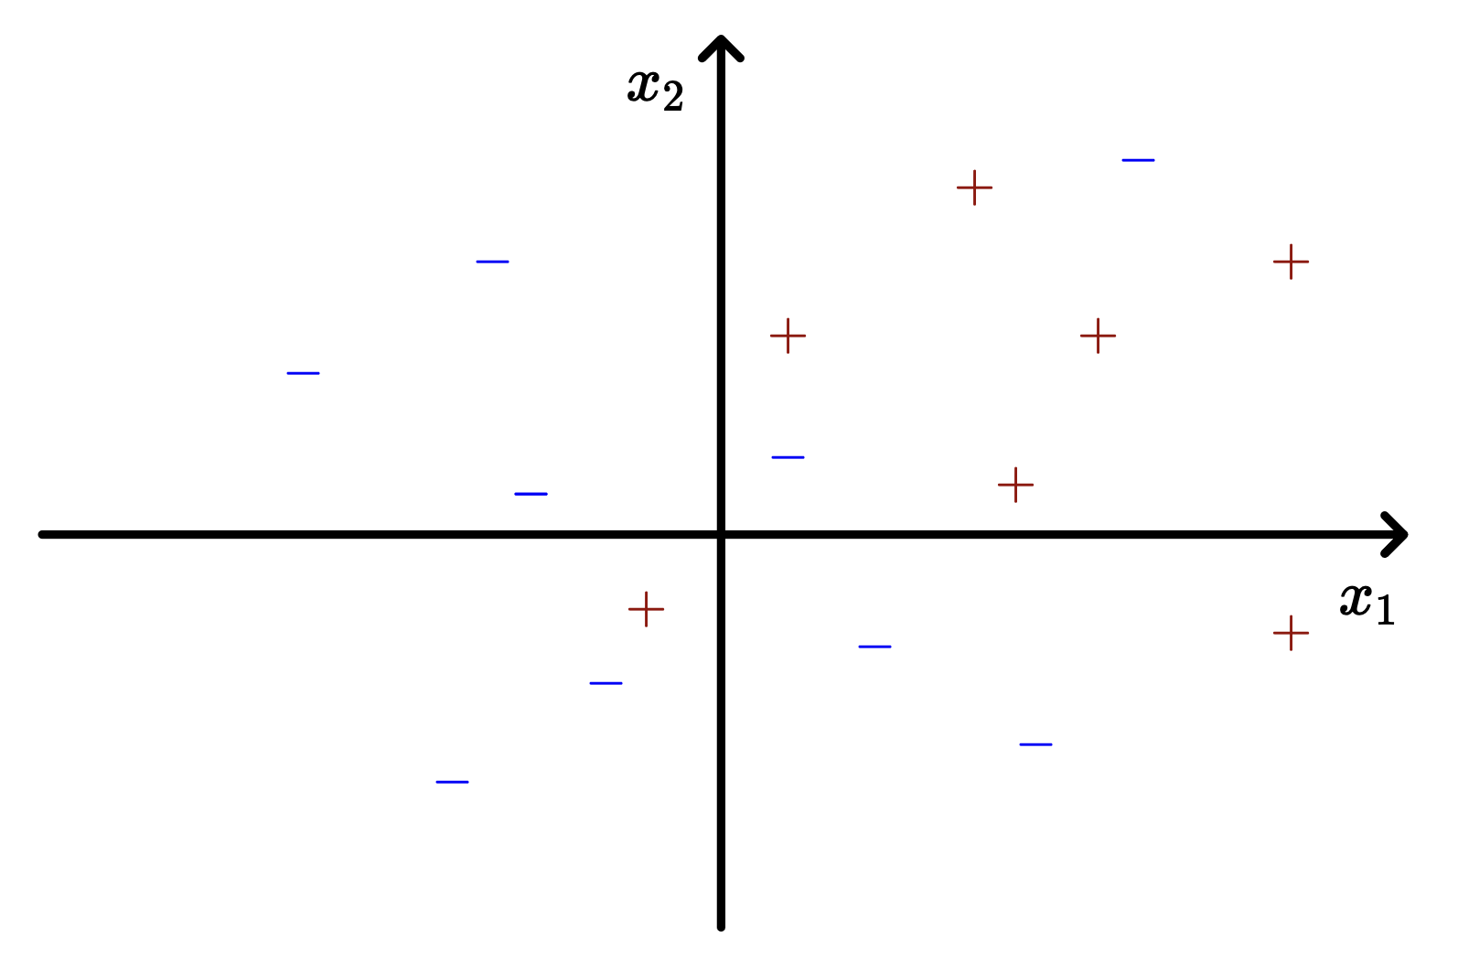
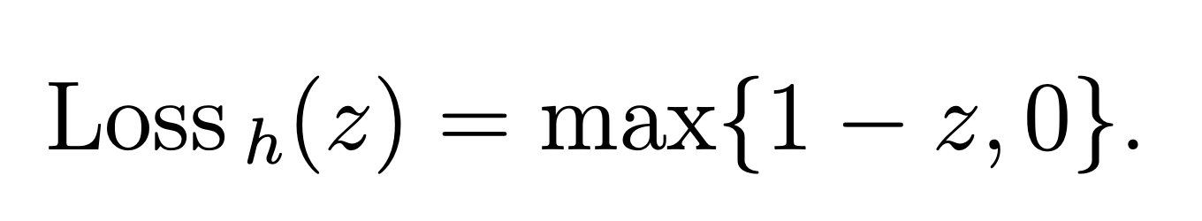
Analogy to the non-realizable case
Recall from SC2300 on Hinge Loss:
The non-realizable case is when our points aren’t linearly separable. So we employ hinge loss to tolerate a margin of error on misclassifications.

Slide 18
Active Classification
A supervised machine learning approach to train a classification model on data where labels are absent or not easily obtainable. It employs an algorithm to query specific points for a label from an oracle (human expert), enough to accurately classify subsequent unlabelled data. This reduces the cost in having to determine all labels needed upfront in passive classification.
 | Active Classification | Passive Classification
Labels | Hidden. Acquired from probing | All provided upfront
Cost | Number of probes | Number of iterations
Examples | Monotone Classifiers (e.g. RPE) | Perceptron

Slide 19

The Problem with k*
In most Active Classification techniques, it requires knowing the Optimal Monotone Error - k* beforehand.
But to know k*, you need to know all labels in P.
To get all labels, you need to probe everything. Defeating the purpose.
In fact, finding an exact optimal classifier requires Ω(n) probes, which is expensive.
We will discuss two algorithms: Random Probes with Elimination (RPE) and Relative Comparison Coresets which instead aims to find a near-optimal classifier with fewer probes without knowing k*.

Slide 20
RPE Speaker Notes
ignore

Slide 21

Random Probes with Elimination
A simple algorithm for monotone classification
Notes:
So, we’ve set up the problem: we have a set of points P, each with a hidden label, and we want to find a good monotone classifier while querying as few labels as possible. Now, let’s to the first algorithm that does this. It's called Random Probes with Elimination, or RPE.
It's deceptively simple, requiring no prior knowledge of k* – the minimum number of mistakes any monotone classifier can make on the dataset. And yet it achieves a 2-approximate solution in expectation with low probing cost.

Slide 22
Key Idea: suppose we’re given a set of points P
Pick a random unlabelled point z from P.
Query the oracle for label(z).
Probe
Notes:
The entire algorithm is just two steps, repeated in a loop.
Step 1: We pick a random unlabelled point and ask the oracle for its label.

Slide 23
Key Idea: suppose we’re given a set of points P
Use monotonicity to instantly determine the labels of many points around z.
Remove them from P.
Pick a random unlabelled point z from P.
Query the oracle for label(z).
Probe
Eliminate
Notes:
Step 2: We use monotonicity to immediately assign labels to a whole region of the space — and remove those points. We don't need to probe them.

Slide 24
Key Idea: suppose we’re given a set of points P
Use monotonicity to instantly determine the labels of many points around z.
Remove them from P.
Pick a random unlabelled point z from P.
Query the oracle for label(z).
Continue on the remaining points whose labels are still unknown.
Stop when P is empty.
Probe
Eliminate
Repeat
Notes:
Then we repeat on what's left i.e. the points whose labels cannot yet be inferred. And we stop when there all points are labelled.

Slide 25
How One Probe Determines Many Labels:
Case 1: label(z) = +1
z
Notes:
So, why does step 2 work? How can one probe determine the labels of many other points?
The key is monotonicity. When we probe a point z and find its label, monotonicity gives us the labels of every point that's comparable to z — meaning every point that's either strictly above z or strictly below z in every feature simultaneously.

Slide 26
How One Probe Determines Many Labels:
Case 1: label(z) = +1
p ⪰ z
z
Monotonicity: h(p) ≥ h(z) = 1
∴ label all these p as +1, remove from P
Notes:
Let’s look at case 1. If label(z) = +1, , then any point p that dominates z — meaning p is at least as large as z on every coordinate — must also be +1. Because if it were -1, that would violate monotonicity. So we can safely label all of them +1 and remove them.

Slide 27
How One Probe Determines Many Labels:
Case 1: label(z) = +1
Case 2: label(z) = -1
z
p ⪰ z
z
Monotonicity: h(p) ≥ h(z) = 1
∴ label all these p as +1, remove from P
Notes:
Now, see case 2. If label(z) = -1, then any point p dominated by z — smaller or equal on every coordinate — must also be -1. Same reasoning. Remove them.

Slide 28
How One Probe Determines Many Labels:
Case 1: label(z) = +1
Case 2: label(z) = -1
z
p ⪰ z
p ⪯ z
z
Monotonicity: h(p) ≥ h(z) = 1
∴ label all these p as +1, remove from P
Monotonicity: h(p) ≤ h(z) = −1
∴ label all these p as −1, remove from P
Notes:
The shaded region in each diagram is essentially the “area of influence” of z — the set of points whose labels are forced. These can be very large, especially in high dimensions. That's what makes RPE efficient.
More intuitively, we can reason that if a point z is positive, then every point above it must also be positive and we remove them. Likewise, if z is negative, then every point below it must also be negative and we remove them. As such, each probe “wipes out” a whole region of points.

Slide 29

Why does RPE work?
Each probe does “double duty”:
Gives its own label
Determines the labels of many points around it
Only uncertain points remain
These will be resolved in subsequent iterations
Many points are resolved
1 Probe
If label(z) = +1: any point p ⪰ z is at least as similar as z on every feature. Monotonicity forces h(p) ≥ h(z) = +1, so all such p must be labelled +1 and can be removed from P.
If label(z) = -1: any point p ⪯ z is dominated by z, so monotonicity forces h(p) ≤ h(z) = -1. All such p must be labelled -1 and are removed.
Notes:
RPE works because each probe does “double duty”. When we pick a random point z and ask the oracle for its label, we don't just learn about z. Monotonicity immediately tells us the labels of a whole region of other points — for free, without any extra probes.
Only the points that are incomparable to z — neither above nor below it — remain uncertain. These are the points the algorithm still needs to probe and resolve in subsequent iterations.

Slide 30
RPE Algorithm
Classifier Output
algorithm RPE(P):
Z = ∅
while P ≠ ∅ do
probe an element z ∈ P chosen uniformly at random; add z to Z
if label(z) = 1:
remove all p ∈ P with p ⪰ z
else:
remove all p ∈ P with z ⪰ p
return Z
Notes:
The actual algorithm is pretty short – only 6 lines!
We start with an empty set Z — this will track every point we've probed. Then we loop: while P is non-empty, pick a uniformly random element z, probe it, and add it to Z. If its label is +1, remove everything that z dominates — that's Line 4. If it's −1, remove everything that dominates z — Line 5. z itself is removed by one of these two lines. Repeat until P is empty.

Slide 31
RPE Algorithm
Classifier Output
algorithm RPE(P):
Z = ∅
while P ≠ ∅ do
probe an element z ∈ P chosen uniformly at random; add z to Z
if label(z) = 1:
remove all p ∈ P with p ⪰ z
else:
remove all p ∈ P with z ⪰ p
return Z
+1 if ∃ z ∈ Z s.t.
label(z)=1 and p ⪰ z;
-1 otherwise.
h_{RPE}(p) = {
A point p is classified as positive if it lies above any known positive point; otherwise it is classified as negative.
So, the algorithm only needs to remember: “Where are the confirmed positive points?”
Notes:
The classifier output is even simpler: label a point p as +1 if it dominates any confirmed positive probe in Z. Otherwise label it −1. So the algorithm really only needs to remember one thing: where are the confirmed positive points?

Slide 32
Is Classifier Always Monotone? Yes.
Suppose there exist points p ⪰ q such that h_{RPE}(p) = -1 and h_{RPE}(q) = +1.
Since h_{RPE}(q) = +1, there exists some z ∈ Z with label(z) = +1 such that q ⪰ z.
Thus, p ⪰ q ⪰ z and by transitivity, p ⪰ z.
If p ⪰ z and label(z) = + 1, h_{RPE}(p) = +1.
Contradiction!
Notes:
You might ask: is this classifier always monotone? Yes — and we can prove this contradiction.
Suppose p dominates q but hRPE(p) = −1 and hRPE(q) = +1. Since q is +1, it dominates some z in Z with label +1. But then p dominates q which dominates z, so p also dominates z by transitivity — which means hRPE(p) should be +1. Contradiction!

Slide 33

Is Classifier Always Monotone? Yes.
Suppose there exist points p ⪰ q such that h_{RPE}(p) = -1 and h_{RPE}(q) = +1.
Since h_{RPE}(q) = +1, there exists some z ∈ Z with label(z) = +1 such that q ⪰ z.
Thus, p ⪰ q ⪰ z and by transitivity, p ⪰ z.
If p ⪰ z and label(z) = + 1, h_{RPE}(p) = +1.
Contradiction!
If a point q is labelled +1, it must be “supported” by some positive probe z. If another point p is even better than q, then p is also better than z.
So, if q is good enough to be +1, then p must also be +1!
Notes:
Put simply, if a point q is labelled +1, it must be “supported” by some positive probe z. If another point p is even better than q, then p is also better than z. So, if q is good enough to be +1, then p must also be +1!

Slide 34
Running Example
p₁₀
p₁₅
p₄
p₁₁
p₁₂
p₃
p₁₃
p₁₄
p₂
p₉
p₁₆
p₅
p₁
p₈
p₆
p₇
Notes:
To see the algorithm in action, let’s trace RPE on this 16-point set. Green points are labelled +1, red points are labelled -1.

Slide 35
Running Example
p₁₀
p₁₅
label +1
Step 1: Probe p₁
p₄
label -1
p₁₁
Oracle reveals label(p₁) = +1
p₁₂
p₃
p₁₃
p₁₄
p₂
p₉
p₁₆
p₅
p₁
p₈
p₆
p₇
Notes:
Suppose RPE randomly selects p₁ as its first probe. The oracle says label(p₁) = +1.

Slide 36
Running Example
p₁₀
p₁₅
label +1
Step 1: Probe p₁
p₄
label -1
p₁₁
Oracle reveals label(p₁) = +1
RPE removes every p ⪰ p₁
p₁₂
p₃
p₁₃
p₁₄
p₂
p₉
p₁₆
p₅
p₁
p₈
p₆
p₇
Notes:
Line 4 of the algorithm kicks in and we remove every point p that dominates p₁. Notice that p₁ sits towards the bottom-left of the figure. This means almost every other point is "more similar than p₁ on every feature", i.e., dominates p₁.

Slide 37
Running Example
p₁₀
p₁₅
label +1
Step 1: Probe p₁
p₄
label -1
p₁₁
Oracle reveals label(p₁) = +1
RPE removes every p ⪰ p₁
p₁₂
p₃
p₁₃
p₁₄
13 points are eliminated
p₂
p₉
p₁₆
p₅
3 points remain: p₆, p₇, p₈
p₁
p₈
Cost = 1 probe
Points determined = 13/16
p₆
p₇
Notes:
So 13 out of 16 points are eliminated in one shot. Only p₆, p₇, and p₈ remain — they're incomparable to p₁, sitting to its lower-right. Their labels are still unknown. And the cost so far is 1 probe.

Slide 38
Running Example
p₁₀
p₁₅
label +1
Step 2: Probe p₈
p₄
label -1
p₁₁
Oracle reveals label(p₈) = -1
p₁₂
p₃
p₁₃
p₁₄
p₂
p₉
p₁₆
p₅
p₁
p₈
p₆
p₇
Notes:
RPE now randomly selects from the remaining three points. Say it picks p₈. The oracle reveals label(p₈) = −1.

Slide 39
Running Example
p₁₀
p₁₅
label +1
Step 2: Probe p₈
p₄
label -1
p₁₁
Oracle reveals label(p₈) = -1
RPE removes every p ⪯ p₈
p₁₂
p₃
p₁₃
p₁₄
p₆, p₇, p₈ are eliminated
p₂
p₉
p₁₆
p₅
p₁
p₈
p₆
p₇
Notes:
Line 5 of the algorithm: we remove everything z ⪰ p₈, i.e., everything that p₈ dominates — which is p₆, p₇, and p₈ itself. P is now empty.

Slide 40
Running Example
p₁₀
p₁₅
label +1
Step 2: Probe p₈
p₄
label -1
p₁₁
Oracle reveals label(p₈) = -1
RPE removes every p ⪯ p₈
p₁₂
p₃
p₁₃
p₁₄
p₆, p₇, p₈ are eliminated
p₂
p₉
p₁₆
p₅
RPE terminates with Z = { p₁ , p₈ }
p₁
p₈
Classifier output:
+1 for all p ⪰ p₁
−1 for all other points
p₆
p₇
Notes:
The algorithm terminates with Z = {p₁, p₈}. Just 2 probes to classify all 16 points.
The output classifier maps every p that dominates p₁ to +1, everything else to −1.

Slide 41
Classifier Output
vs.
True Labels
err_{P}(h_{RPE}) = 5
cost = 2 probes
p₁₀
p₁₅
p₁₀
p₁₅
p₄
p₄
p₁₁
p₁₁
p₁₂
p₁₂
p₃
p₁₃
p₃
p₁₃
p₁₄
p₁₄
p₂
p₉
p₁₆
p₂
p₉
p₁₆
p₅
p₅
p₁
p₁
p₈
5 red points mapped to +1
p₈
p₆
p₇
p₆
p₇
Note: error = 5 ≥ k* = 3 but error = 5 ≤ 2k* = 6, where k* = min. #mistakes any monotone classifier can make
Notes:
Let’s check the classifier’s output against the true labels. As we can see, 5 red points were misclassified as green i.e. labelled +1 instead of -1. So, the total error = 5.
RPE does not need to know k* to work – which we recall is the minimum number of mistakes any monotone classifier can make on the dataset. In this case, k* = 3, so the RPE classifier’s error is worse, but it’s still below 2k* = 6. We will look at this upper bound later, but this is the expected trade-off: RPE probes very few points but may produce a somewhat suboptimal classifier.
k* is the minimum number of mistakes any monotone classifier can make on the dataset
i.e. “minimum number of points to change so labels become monotone”
p1, p11, p15 in this case
Consider the monotone classifier h that maps (i) all the green points to 1 except p1, and (ii)
all the red points to −1 except p11 and p15. Thus, errP(h) = 3. No other monotone classifier has
a smaller error on P and, hence, k∗= 3

Slide 42
Theorem 2.1 – Formal Guarantees
Expected Error
E[err_{P}(h_{RPE})] ≤ 2k*
i.e. expected error is at most twice the optimal monotone error, regardless of input
Note: Guarantee is in expectation → a single run may exceed 2k*
Notes:
RPE satisfies 2 things.
First, the expected error is at most 2k*. So on average across random runs, RPE makes at most twice as many mistakes as the best possible monotone classifier.

Slide 43
Theorem 2.1 – Formal Guarantees
Expected Error
E[err_{P}(h_{RPE})] ≤ 2k*
i.e. expected error is at most twice the optimal monotone error, regardless of input
Note: Guarantee is in expectation → a single run may exceed 2k*
Special case: k* = 0 → 2k* = 0
RPE always finds a perfect classifier.
Notes:
In the special case that k* = 0, 2k* = 0 so RPE will always find a perfect classifier.
However, we must note that the upper bound error guarantee is in expectation. Any particular of the algorithm may do worse i.e. result in an error exceeding 2k*.

Slide 44
Theorem 2.1 – Formal Guarantees
Expected Error
Expected Cost
E[err_{P}(h_{RPE})] ≤ 2k*
i.e. expected error is at most twice the optimal monotone error, regardless of input
Note: Guarantee is in expectation → a single run may exceed 2k*
O(w⋅log(n/w)),
where w is the dominance width of P, n = |P|, and log(x) = log₂(1 + x)
Far fewer than naive n probes!
Note: RPE never needs to compute w – the width is only used in analysis
Special case: k* = 0 → 2k* = 0
RPE always finds a perfect classifier.
w = max. number of mutually incomparable points
Notes:
Second, the expected number of probes is O(w · log(n/w)) — far fewer than the naïve approach of probing all n points. The key parameter here is w, the dominance width — the size of the largest set of mutually incomparable points.
Note that RPE never computes w. The width only appears in the analysis, not the algorithm itself.

Slide 45
Proof: Why E[err_{P}(h_{RPE})] ≤ 2k*
Fix the optimal classifier h*. Classify every point as:
h*-good
if h*(p) = label(p)
h*-bad
if h*(p) ≠ label(p)
There are exactly k* h*bad points.
Lemma 2.1. Expected # of h*-good points misclassified by h_{RPE} ≤ k*
k* bad points
(always wrong)
+
≤ k* good points
(misclassified)
≤ 2k*
Notes:
How do we prove the expectation of error is ≤ 2k*? The proof proceeds by induction.
First, we fix any monotone classifier h. Partition P into h-good points and h-bad points. h-good points are points that are correctly classified by h i.e. h(p) = label(p). h-bad points are points that are misclassified by h i.e. h(p) ≠ label(p).
Setting h = h* which is the optimal classifier, there are exactly k* bad points.
Lemma 2.1 says that the expected number of h*-good points that RPE misclassifies is at most k*. Add the k* bad points (which are always misclassified regardless), and total expected error ≤ 2k*.

Slide 46
Proof: Why E[err_{P}(h_{RPE})] ≤ 2k*
When RPE probes a point, it can cause other points to be misclassified:
Fix the optimal classifier h*. Classify every point as:
I_{bad}(p) for each h*-bad point p:
set of h*-good points that get forced to the wrong label if p is the first probe.
h*-good
if h*(p) = label(p)
h*-bad
if h*(p) ≠ label(p)
There are exactly k* h*bad points.
I_{good}(q) for each h*-good point q:
set of h*-bad points that get forced to the wrong label if q is the first probe.
Lemma 2.1. Expected # of h*-good points misclassified by h_{RPE} ≤ k* (# of h*-bad points)
Lemma 2.2. q ∈ I_{bad}(p) ⟺ p ∈ I_{good}(q)
→ Σ_{p∈bad} |I_{bad}(p)| = Σ_{q∈good} |I_{good}(q)|
k* bad points
(always wrong)
+
≤ k* good points
(misclassified)
≤ 2k*
total “potential for error” = total “potential for correction”
Note: h* is used here to prove the expected error bound, but the lemmas and terms apply for any monotone classifier h.
Notes:
The tool that makes Lemma 2 work is the symmetry of influence sets. For each bad point p, define I_bad(p) as the set of good points that would get misclassified if p were probed first. For each good point q, I_good(q) is the set of bad points that would get 'corrected' if q were probed first.
By Lemma 2.2, these two quantities sum to the same total. That is, the total 'potential for error’ from bad points equals the total 'potential for correction’ from good points. This balance is what allows the inductive argument to close at exactly err_P(h).

Slide 47
Proof: Why O(w⋅log(n/w)) Probes
1. Dilworth’s Theorem
Any P can be partitioned into exactly w disjoint chains (where every point in a chain is comparable to others).
Two points p and q are comparable if:
p ⪰ q or q ⪰ p
Intuition: Comparable = “we can clearly say one is better (or equal) in all aspects”
Notes:
Now, let’s prove why RPE costs at most O(w⋅log(n/w)) probes.
First, by Dilworth's Theorem, any point set P can be partitioned into exactly w disjoint chains — subsets where every two points are comparable to each other. Recall that two points p and q are comparable if p dominates q or q dominates p. That is, we can clearly say one is better (or equal) in all aspects.

Slide 48
Proof: Why O(w⋅log(n/w)) Probes
1. Dilworth’s Theorem
Recall earlier example:
p₁₀
p₁₅
Any P can be partitioned into exactly w disjoint chains (where every point in a chain is comparable to others).
e.g., P can be decomposed into 6 chains:
C₁ = {p₁, p₂, p₃,p₄, p₁₀}
C₂ = {p₁₁}
C₃ = {p₅, p₉, p₁₂}
C₄ = {p₁₆}
C₅ = {p₁₃}
C₆ = {p₆, p₇, p₈,p₁₄, p₁₅}
p₄
p₁₁
p₁₂
p₃
p₁₃
p₁₄
p₂
p₉
p₁₆
p₅
p₁
p₈
p₆
p₇
Notes:
Taking the earlier example, we can decompose P into 6 chains shown here.

Slide 49
Proof: Why O(w⋅log(n/w)) Probes
1. Dilworth’s Theorem
2. A&E Game per chain
Any P can be partitioned into exactly w disjoint chains (where every point in a chain is comparable to others).
Two points p and q are comparable if:
p ⪰ q or q ⪰ p
Intuition: Comparable = “we can clearly say one is better (or equal) in all aspects”
Two-player Attrition-and-Elimination (A&E) game on each chain of m points.
Bob (adversary): delete any subset of points
Alice: pick a random p and delete all q ⪰ p
Each round halves the chain with probability > 1/2
R1
R2
R3
R4
Notes:
Second, we can model RPE's behaviour on each chain as an Attrition-and-Elimination game.
An adversary (Bob) removes some points each round to make things hard. Then Alice picks a random point p and eliminates all points q that dominate p i.e. deletes everything above p.

Slide 50
Proof: Why O(w⋅log(n/w)) Probes
1. Dilworth’s Theorem
2. A&E Game per chain
Any P can be partitioned into exactly w disjoint chains (where every point in a chain is comparable to others).
Two points p and q are comparable if:
p ⪰ q or q ⪰ p
Intuition: Comparable = “we can clearly say one is better (or equal) in all aspects”
Two-player Attrition-and-Elimination (A&E) game on each chain of m points.
Bob (adversary): delete any subset of points
Alice: pick a random p and delete all q ⪰ p
Lemma 2.3. E[rounds] = O(log m), regardless of Bob’s strategy
Each round halves the chain with probability > 1/2
Notes:
The key insight is that regardless of Bob's strategy, Alice's random pick falls in the lower half of the remaining chain with probability greater than 1/2. So each round halves the chain with probability > 1/2, and by a standard halving argument, the game ends in O(log m) expected rounds for a chain of size m.

Slide 51
Proof: Why O(w⋅log(n/w)) Probes
1. Dilworth’s Theorem
2. A&E Game per chain
Any P can be partitioned into exactly w disjoint chains (where every point in a chain is comparable to others).
Two-player Attrition-and-Elimination (A&E) game on each chain of m points.
Sum O(log |C_{i}|) over all w chains: Σ_{i} log |C_{i}|
Jensen’s Inequality: ≤ w ⋅ log (n/w)
Final bound: O(w⋅log(n/w))
Notes:
Finally, we sum across all w chains, gettingΣ O(log |Cᵢ|), and by Jensen's inequality — log is concave, so the sum is maximised when all chains have equal size n/w — this gives O(w · log(n/w)) total expected probes.

Slide 52
Factor of 2-Error is Asymptotically Tight
Monotone classifier that maps all points to -1 misclassifies only the green point, so k* = 1.
label +1
label -1
n - 1 red points
no point dominates any other (width w = n)
Notes:
So RPE guarantees 2k* error in expectation. You might wonder: can we do better? Can we get the error down to, say, 1.5k* just by being cleverer with random probing? The answer is no. The factor of 2 is asymptotically tight for RPE.
Let’s illustrate this using an example. Take n−1 red points (label −1) and one green point (label +1), arranged so no point dominates any other. The optimal classifier maps everything to −1, giving k* = 1.

Slide 53
Factor of 2-Error is Asymptotically Tight
Prob. 1/n: RPE probes green point first
it dominates no other point → no eliminations → all n - 1 red points remain and get mapped to +1
Error = n - 1 (note: this is ≥ 2k* = 2)
label +1
label -1
n - 1 red points
no point dominates any other (width w = n)
Notes:
With probability 1/n, RPE probes the green point first. It dominates nothing, so no eliminations occur. All n−1 red points remain and eventually get labelled +1. These misclassifications result in error n−1. Note that this is ≥ 2k* = 2, showing that a single run of RPE may exceed the guaranteed expected error bound.

Slide 54
Factor of 2-Error is Asymptotically Tight
Prob. 1/n: RPE probes green point first
it dominates no other point → no eliminations → all n - 1 red points remain and get mapped to +1
Error = n - 1 (note: this is ≥ 2k* = 2)
label +1
label -1
Prob. 1 - 1/n: RPE probes a red point first
red dominates nothing → removes only itself → only green point remains and gets mapped to -1
Error = 1
n - 1 red points
no point dominates any other (width w = n)
Notes:
With probability 1−1/n, a red point is probed first. Red points dominate nothing, so we remove only these points. Only the green point remains and gets mapped to -1. This misclassification gives error = 1.

Slide 55
Factor of 2-Error is Asymptotically Tight
Prob. 1/n: RPE probes green point first
it dominates no other point → no eliminations → all n - 1 red points remain and get mapped to +1
Error = n - 1 (note: this is ≥ 2k* = 2)
label +1
label -1
Prob. 1 - 1/n: RPE probes a red point first
red dominates nothing → removes only itself → only green point remains and gets mapped to -1
Error = 1
n - 1 red points
no point dominates any other (width w = n)
E[err(h_{RPE})] = (1/n)(n-1) + (1-1/n)(1) = 2 - 2/n
→ 2 as n → ∞
Approximation ratio → 2k*/k* = 2. Factor of 2 is asymptotically tight – RPE cannot do better.
Notes:
We can calculate the expected error = (1/n)(n−1) + (1−1/n)(1) = 2 − 2/n, which approaches 2 as n goes to infinity.
Since k* = 1, the approximation ratio approaches 2k*/k* which 2.
No modification to RPE's random-probing strategy can beat this.

Slide 56
Summary of RPE
Core Idea:
Randomly probe a few points
Use monotonicity to infer others
Performance:
E[err_{P}(h_{RPE})] ≤ 2k*
O(w⋅log(n/w)) probes
Main Advantage:
No need to know k* (calculating eaxct k* is not trivial → requires solving a global optimization problem)
Limitations:
Factor of 2-error is tight
Guarantee is in expectation only
Notes:
Let me wrap up the key ideas from the RPE algorithm.
The main idea is that instead of labeling every point, we randomly probe a few points and use the monotonicity property to infer many others. This works because each probe doesn’t just give us one label — it actually determines the labels of an entire region of points. So over time, we only need to focus on the uncertain points.
In terms of performance, RPE is quite strong. It achieves an error that is at most twice the optimal monotone error, and it does so using far fewer probes — roughly O of w log n over w.
The main advantage of RPE is that is requires no knowledge of k*. Most active learning algorithms need ξ as a parameter, which requires knowing ν = k*/n. Calculating the exact k* is not trivial and requires solving a global optimization problem.
So the key takeaway is that a small number of carefully chosen queries can replace labeling the entire dataset, which is especially useful when labeling is expensive.
However, there are two limitations: the factor of 2 error cannot be improved, and the guarantee only holds in expectation.
And this sets the stage for more advanced methods that further improve the accuracy.

Slide 57
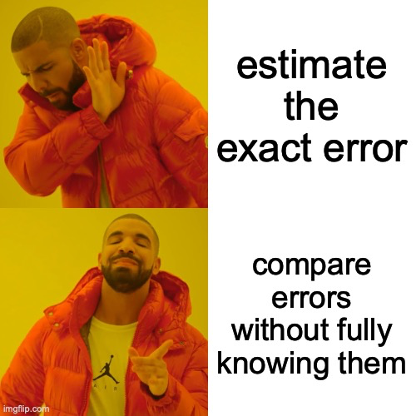
Relative-Comparison Coresets
Notes:
So the previous speaker showed us RPE — a clever technique to approximate errors by random probing. But as we're about to see, RPE has a fundamental limitation. Today I'll be talking about how we go beyond it using something called Relative-Comparison Coresets, or RCC for short.
The meme on this slide actually captures the key idea perfectly. Instead of trying to estimate the exact error — which is expensive — or even approximating it like RPE does, we take a smarter approach: we compare errors without ever fully knowing them. That shift in perspective is what this whole section is about.

Slide 58
What’s wrong with RPE?
RPE achieves an expected error of at most 2k*
→ guarantee is tight, we can't do better
→ unacceptable for a production pipeline
😠
Notes:
Let's start with the limitation. RPE gives us an expected error of at most 2k*, where k* is the optimal error. And this guarantee is tight — meaning we can't squeeze a better bound out of RPE, no matter what we do.
For a research prototype, 2k* might be acceptable. But imagine you're running a production entity-matching pipeline — say, deduplicating a massive customer database. A factor-of-2 error margin could mean millions of incorrect merges. That's unacceptable.
What we really want is an error of (1 + ε) · k* for any ε we choose — say, 1%, or 0.1%. So the question becomes: can we do better than factor 2?

Slide 59
Estimating the true error directly is too
expensive… but do we actually need
the exact value?
🤔
Notes:
Before we answer that, let's think about why this is hard. The natural idea would be: just estimate err(h) directly by probing some points and extrapolating. Done.
But here's the problem — estimating the true error directly is too expensive. And the next slide shows exactly why.

Slide 60
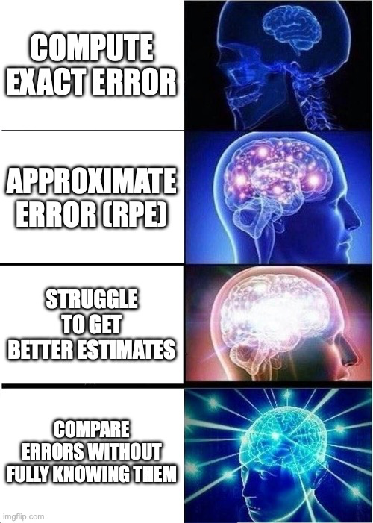

Notes:
This meme shows four levels of sophistication. Computing the exact error is the most naive approach. Approximating it with RPE is smarter. Struggling to get better estimates is the brute-force path — and it leads nowhere good. But the galaxy-brain move? Comparing errors without fully knowing them. That's the insight this section builds on.

Slide 61
Why can’t we estimate err_{p}(h) directly?
+
+
+
+
+
-
+
How long would it take to find -1?
Even for h_{pos} (all +1), finding whether a single −1 exists needs Ω(n) probes.
Notes:
Here's the concrete lower bound. Consider the simplest possible classifier: h_pos, which labels everything as +1. To estimate its error, you'd need to find at least one −1 label in the dataset — or confirm that none exists. In the worst case, the single −1 element is the very last one you probe. That requires Ω(n) probes in expectation. You'd have to look at almost the whole dataset just to pin down one classifier's error.
And remember, we need this to hold simultaneously for all classifiers — there are infinitely many of them. So direct estimation is completely off the table.

Slide 62
The Goal: A Proxy Function F
Find a function F : H_mon → ℝ as a proxy for true error
comparing F(h) vs F(h') tells us which classifier is better
Comparison Property:
If F(h) ≤ F(h'), then err(h) ≤ (1+ɛ)·err(h')
Since F(h) ≤ F(h*) for any optimal h*, this gives err(h) ≤ (1+ɛ)·k*
Notes:
So instead of computing errors directly, we look for a proxy function F. We want F to map each classifier h to a real number, such that comparing F(h) versus F(h') reliably tells us which classifier is better.
Formally, we want the Comparison Property: if F(h) ≤ F(h'), then err(h) ≤ (1 + ε) · err(h'). And since F(h) ≤ F(h*) for the optimal classifier h*, this gives us err(ĥ) ≤ (1 + ε) · k*. That's our target guarantee.
The question is: how do we build such an F cheaply?

Slide 63
⭐ The Unknown Delta Technique ⭐
Instead of estimating err(h) exactly, we find an F where all estimates are shifted by the same unknown Δ
errₚ(h)(1 − ɛ/4) + Δ ≤ F(h) ≤ errₚ(h)(1 + ɛ/4) + Δ for all h ∈ H_mon
🔑 Key Insight: Δ cancels whenever we compare two classifiers — we never need to know its value
Notes:
This is the core idea of the entire section, so pay close attention.
Instead of requiring F(h) to be close to err(h) in absolute terms, we allow all the estimates to be shifted by the same unknown constant Δ. The guarantee we require is:
err_P(h)(1 − ε/4) + Δ ≤ F(h) ≤ err_P(h)(1 + ε/4) + Δ, for all h ∈ H_mon
The key insight — highlighted here — is that Δ cancels whenever we compare two classifiers. We never need to know its value. We only ever use F to compare, never to read off an absolute error. That's the trick.
This is a genuinely elegant idea. We're not hiding Δ or ignoring it — we're deliberately designing our function so that Δ doesn't matter for the task we actually care about.

Slide 64
⭐ The Unknown Delta Technique ⭐
errₚ(h)(1 − ɛ/4) + Δ ≤ F(h) ≤ errₚ(h)(1 + ɛ/4) + Δ for all h ∈ H_mon
Proof of Comparison Property
Suppose F(h) ≤ F(h').
errₚ(h)(1−ɛ/4) + Δ ≤ F(h)
F(h') ≤ errₚ(h')(1+ɛ/4) + Δ
Cancel Δ → errₚ(h) ≤ (1+ɛ)·errₚ(h')
Why Δ Doesn't Matter
Δ is the same constant in F(h) and F(h').
Subtracting them eliminates Δ entirely.
We only compare and never compute
an absolute error. That's the trick.
Notes:
Let's verify this actually works. Suppose F(h) ≤ F(h').
Step 1: From the left inequality for h: err_P(h) · (1 − ε/4) + Δ ≤ F(h).
Step 2: From the right inequality for h': F(h') ≤ err_P(h') · (1 + ε/4) + Δ.
Since F(h) ≤ F(h'), chaining these gives:
err_P(h) · (1 − ε/4) + Δ ≤ err_P(h') · (1 + ε/4) + Δ
The Δ terms on both sides cancel exactly. Rearranging, and using the fact that (1 + ε/4)/(1 − ε/4) ≤ (1 + ε) for ε ∈ (0,1], we get:
err_P(h) ≤ (1 + ε) · err_P(h')
That's the comparison property. Notice we never computed Δ — it was just a ghost that vanished.

Slide 65
Relative-Comparison Coreset (RCC)
Full Dataset P
All n points
Labels: unknown until probed
RCC Z
Small weighted subset of P
Labels revealed, weights > 0
w-err_{Z}(h) = Σ weight(z)
Notes:
Now we need to actually construct this proxy function F. The vehicle for doing so is the Relative-Comparison Coreset.
A coreset Z is a small weighted subset of the full dataset P. Crucially, the labels of points in Z are revealed — we've probed them. Each point z carries a positive weight. The weighted error of a classifier h on Z is defined as the sum of weights of all misclassified points in Z.
The coreset Z acts as our proxy: w-errZ(h) plays the role of F(h). The promise is that this weighted error satisfies the Unknown-Δ condition for all h simultaneously — even though Z is tiny compared to P.

Slide 66
Relative-Comparison Coreset (RCC)
With O(w/ε² · log(nw/δ) · log n) probes, obtain coreset Z of the same size w.h.p., such that every h ∈ H_mon satisfies:
errₚ(h)(1−ε/4) + Δ ≤ w-err_{Z}(h) ≤ errₚ(h)(1+ε/4) + Δ
for some unknown Δ.
w-errZ(h) satisfies the relative ε-comparison property & serves as the desired function F
Notes:
Here's what we can achieve. With O(w/ε² · log(nw/δ) · log n) probes, we can build a coreset Z of the same size such that, with high probability, for every h ∈ H_mon:
err_P(h)(1 − ε/4) + Δ ≤ w-errZ(h) ≤ err_P(h)(1 + ε/4) + Δ
for some unknown Δ. And since w-errZ satisfies this, it serves directly as our desired function F — with all the comparison guarantees we just proved.

Slide 67
What We're About to Prove
The rest of the section proves Theorem 6 by
Theorem 6
Let n and w be the size and width of the input P to Problem 1.
In O(w/ε² · Log (n/w) · log (n/δ)) probes, we can obtain with probability at least 1-δ a relative comparison coreset Z of P with size |Z| = O(w/ε² · Log (n/w) · log (n/δ)).
Establishing its correctness for d = 1 by at least 1- δ by probing O(w/ε2 · Log (n/w) · log (n/δ)) elements
Utilising solution to build a relative-comparison coreset that meets the requirements of Theorem 6 for d=1.
Extending the discussion for d>1
Notes:
The rest of this section is devoted to proving Theorem 6, which states: given a dataset of size n and width w, we can build a relative-comparison coreset using O(w/ε² · log(n/w) · log(n/δ)) probes.
We do this in three steps. First, we establish correctness for d = 1 — the one-dimensional case. Second, we use that solution to actually construct the coreset. Third, we extend to d > 1 using Dilworth's Theorem, which the previous speaker already introduced.
Let's go through each step.

Slide 68
The 1D Function Approximation
Let P be a multiset of 1D labeled points and ε ∈ (0,1]. Find F : H_{mon} → ℝ such that every h ∈ H_{mon} satisfies simultaneously:
|F(h) − errₚ(h)| ≤ ε|P| / 64
errₚ(h)(1 − ε/4) + Δ ≤ F(h) ≤ errₚ(h)(1 + ε/4) + Δ
for some (possibly unknown) Δ with |Δ| ≤ ε|P| / 64
The 1D construction works by solving the following problem at every level of recursion. The coreset is built by the algorithm BuildCoreset, which solves the problem recursively.
Notes:
For d = 1, the building block we need to solve at each level of recursion is: given a multiset Q of 1D labeled points, find F : H_mon → ℝ such that for all h ∈ H_mon simultaneously:
|F(h) − err_Q(h)| ≤ ε|Q|/64 — F is close to the true error in absolute terms
err_Q(h)(1 − ε/4) + Δ ≤ F(h) ≤ err_Q(h)(1 + ε/4) + Δ — the shifted approximation condition
with |Δ| ≤ ε|Q|/64. This is the sub-problem that the recursive algorithm BuildCoreset solves at each level.

Slide 69
Sample & Estimate
BuildCoreset(P)
Z ← ∅
If |P| = 1:
Probe the single element p
Z ← {p} with weight(p) = 1
Else:
Probe sample S₁ of size O(1/ɛ² · log( (|P| ℓ) / δ),
where ℓ = log(n)
Use G₁ to find α, β → split P_{α}, P_{mid}, P_{rest}
if P_{rest} ≠ ∅:
Probe S₂ from P_{rest}; add to Z with weight |P_{rest}| / |S₂|
if P_{α} ≠ ∅:
Probe S_{α} from P_{α}; add to Z with weight |P_{α}| / |S_{α}|
Z_{mid} ← BuildCoreset(P_{mid})
Add Z_{mid} to Z
Return Z
Split into Three Parts
Assemble the Coreset
Recursion
Notes:
Here's the algorithm at a high level.
Base case: if P has a single element, probe it, add it to Z with weight 1, and return.
Recursive case:
Draw a sample S₁ from the full P. Use it to compute G₁, which locates split points α and β.
This partitions P into three parts: P_α (points equal to α), P_mid (between α and β), and P_rest (everything else).
For P_rest: draw sample S₂, add it to Z with weight |P_rest|/|S₂|.
For P_α: draw sample S_α, add it to Z with weight |P_α|/|S_α|.
Recurse on P_mid and merge the result into Z.
The weights are crucial — they ensure the weighted error on Z correctly scales up to represent all of P.

Slide 70
Step 1: Sampling & Estimation
Draw uniform sample S from Q.
For each h in H_{mon,} we define G(h) = ( |Q| / |S| ) · err_{S}(h).
G₁
Source: Full P
Locates split points α and β
Does NOT enter coreset
G₂
Source: P_{rest} Approximates errP_{rest}(h)
Sample S₂ enters Z with weight |P_{rest}| / |S₂|
F_{α}
Source: P_{α}
Approximates errP_{α}(h)
Sample S_{α} enters Z with weight |P_{α}| / |S_{α}|
F(h) = G₂(h) + F_{α}(h) + F_{mid}(h)
F_{mid} comes from recursion on P_{mid}
If α = β= null, then F_{α}(h) = F_{mid}(h) = 0, leaving F(h) = G₂(h).
Notes:
Let's unpack what each piece does. The total proxy function is:
F(h) = G₂(h) + F_α(h) + F_mid(h)
G₁ is sampled from the full P. Its job is purely structural — to locate the split points α and β. It never enters the coreset Z.
G₂ is sampled from P_rest. It approximates the error on P_rest, and its sample S₂ enters Z with weight |P_rest|/|S₂|.
F_α is sampled from P_α. It approximates the error on P_α, and S_α enters Z with weight |P_α|/|S_α|.
F_mid comes from the recursive call on P_mid.
If no α or β is found, then F_α and F_mid are zero, and F(h) = G₂(h) alone.
The construction of G is simple: draw a uniform sample S from a set Q, and define G(h) = (|Q|/|S|) · err_S(h). This scaled count is an unbiased estimator of err_Q(h).

Slide 71
Step 1: Sampling & Estimation
Draw uniform sample S from Q.
For each h in H_{mon,} we define G(h) = ( |Q| / |S| ) · err_{S}(h).
Problem: G₁ and G₂ need to satisfy their conditions for all h ∈ H_{mon}, but H_{mon} is infinite, so a union bound over all classifiers seems impossible.
Solution: use H^{P}_{mon} as the finite stand in for H_{mon}
H_{mon} contains infinitely many threshold classifiers.
H^{P}_{mon} keeps only at most |P|+1 thresholds that actually land on or below a point in P, since all others behave identically on P.
|H^{P}_{mon}| ≤ |P|+1, so a union bound over classifiers now costs a log(|P|) factor, which is where the log|P| in O(1/ε² · log(|P|·ℓ/δ)) comes from.
G₁
Source: Full P
Locates split points α and β
Does NOT enter coreset
G₂
Source: P_{rest} Approximates errP_{rest}(h)
Sample S₂ enters Z with weight |P_{rest}| / |S₂|
F_{α}
Source: P_{α}
Approximates errP_{α}(h)
Sample S_{α} enters Z with weight |P_{α}| / |S_{α}|
F(h) = G₂(h) + F_{α}(h) + F_{mid}(h)
F_{mid} comes from recursion on P_{mid}
If α = β= null, then F_{α}(h) = F_{mid}(h) = 0, leaving F(h) = G₂(h).
Notes:
There's a subtle issue here. G₁ and G₂ need to satisfy their conditions simultaneously for all h ∈ H_mon. But H_mon contains infinitely many threshold classifiers — so a naive union bound over all of them is impossible.
The fix is to observe that only |P| + 1 distinct thresholds actually produce different labellings on P — specifically those that fall on or between points of P. All other thresholds behave identically to one of these. So we replace H_mon with the finite set H_mon^P, which has at most |P| + 1 elements.
Now we can take a union bound over this finite set, and it costs a log|P| factor — which is exactly where the log|P| in the sample size comes from.

Slide 72
Example
P = {1, 2, 3, 4, 5, 6, 7, 8}, ɛ = 1/2
h* = h₄
-1
-1
-1
-1
+1
+1
+1
+1
x-coordinate (1D, points sorted left to right)
1
2
3
4
5
6
7
8
Optimal Classifier:
h₄: classify +1 if p > 4
k* = 0

Slide 73
Example: Sample S₁
-1
-1
-1
-1
+1
+1
+1
+1
x-coordinate (1D, points sorted left to right)
1
2
3
4
5
6
7
8

Slide 74
Example: Compute G₁
h* = h₄_{.5}
-1
-1
-1
-1
+1
+1
+1
+1
1
2
3
4
5
6
7
8
h_{τ} | True err_{P}(h_{τ}) | err_{S1}h | G₁
h_{pos} (all +1) | 4 | 1 | 2.67
h₁ | 3 | 1 | 2.67
h₂ | 2 | 0 | 0
h₃ | 1 | 0 | 0
h₄ | 0 | 0 | 0
G₁(h) = ( |Q| / |S| ) · err_{S}(h).

Slide 75
Example: Compute G₁
-1
-1
-1
-1
+1
+1
+1
+1
1
2
3
4
5
6
7
8
h_{τ} | True err_{P}(h_{τ}) | err_{S1}h | G₁
h₅ | 1 | 1 | 2.67
h₆ | 2 | 1 | 2.67
h₇ | 3 | 2 | 5.33
h₈ | 4 | 2 | 5.33
G₁(h) = ( |Q| / |S| ) · err_{S}(h).

Slide 76
Step 2: Splitting P into 3 Parts
The purpose of G₁ is to identify where the error function transitions through the value |P| / 4.
Define: α = smallest τ ∈ P ∪ {−∞} with G₁(h_{τ} ) < |P| (1/4 − ε/64)
β = largest τ ∈ P ∪ {−∞} with G₁(h_{τ} ) < |P| (1/4 − ε/64)
P_{α} = {p ∈ P : p = α}
P_{mid} = {p ∈ P : α < p ≤ β}
|P_{mid}| < |P| / 2
P_{rest} = P \ (P_{α} ∪ P_{mid})
Each recursion halves P_{mid.} After O(log n) levels, P_{mid} = 1. Total recursion depth is bounded → algorithm terminates.
Notes:
So what does G₁ actually do? Its job is to find where the error function transitions through the value |P|/4.
We define:
α = the smallest threshold τ such that G₁(h_τ) < |P|(1/4 − ε/64)
β = the largest such threshold
Points in P are then partitioned: P_α = {p = α}, P_mid = {α < p ≤ β}, P_rest = everything else.
The critical fact is that |P_mid| < |P|/2 at every level. Here's why intuitively: P_mid can't contain more than |P|/4 positive-label points (otherwise G₁(h_β) would exceed the threshold, contradicting the definition of β). By a symmetric argument, it can't contain more than |P|/4 negative-label points. So |P_mid| < |P|/2.
This means each recursive call halves P_mid. After O(log n) levels, P_mid reaches size 1 and the recursion terminates.

Slide 77
Example: Calculate Threshold
-1
-1
-1
-1
+1
+1
+1
+1
x-coordinate (1D, points sorted left to right)
1
2
3
4
5
6
7
8
Threshold = |P| (1/4 − ε/64) ≈ 1.94

Slide 78
Example: Compute α and β
h* = h₄_{.5}
-1
-1
-1
-1
+1
+1
+1
+1
1
2
3
4
5
6
7
8
h_{τ} | True err_{P}(h_{τ}) | err_{S1}h | G₁ | vs Threshold = 1.94
h_{pos} (all +1) | 4 | 1 | 2.67 | >
h₁ | 3 | 1 | 2.67 | >
h₂ | 2 | 0 | 0 | <
h₃ | 1 | 0 | 0 | <
h₄ | 0 | 0 | 0 | <
α = 2 and β = 4

Slide 79
Example: Split P into P_{α}, P_{mid}, P_{rest}
-1
-1
-1
-1
+1
+1
+1
+1
1
2
3
4
5
6
7
8
P_{rest}
P_{α}
P_{mid}
P_{rest}
|P_{mid}| < |P| / 2 holds!

Slide 80
Step 3: Assembling the Coreset Z
Z
Sample S₂ from P_{rest} with weight |P_{rest}| / |S₂|
Z_{mid} from recursion
Sample S_{α} from P_{α} with weight |P_{α}| / |S_{α}|
Why weights? Each sampled point represents multiple original points. Weight = (set size) / (sample size) undoes the sub-sampling so w-err_{Z} correctly scales back to represent all of P.
Notes:
To assemble Z, we combine three components:
Sample S₂ from P_rest, with weight |P_rest|/|S₂|
Sample S_α from P_α, with weight |P_α|/|S_α|
Sub-coreset Z_mid returned from the recursion
The weight assignment is important: each sampled point represents many original points it was drawn from. The weight = (set size)/(sample size) effectively undoes the sub-sampling, ensuring that w-errZ scales back correctly to represent all of P. Without this, the weighted error would be systematically underestimated.

Slide 81
Example: Sample S₂ from P_{rest} & S_{α} from P_{α}
-1
-1
-1
-1
+1
+1
+1
+1
1
2
3
4
5
6
7
8
P_{rest}
P_{α}
P_{mid}
P_{rest}

Slide 82
Example: Sample S₂ from P_{rest} & S_{α} from P_{α}
-1
-1
-1
-1
+1
+1
+1
+1
1
2
3
4
5
6
7
8
P_{rest}
P_{α}
P_{mid}
P_{rest}
RCC Z

Slide 83
Example: Sample S₂ from P_{rest} & S_{α} from P_{α}
-1
-1
-1
+1
+1
+1
+1
-1
1
3
4
5
6
7
8
P_{rest}
P_{α}
P_{mid}
P_{rest}
RCC Z
2

Slide 84
Example: Sample S₂ from P_{rest} & S_{α} from P_{α}
-1
-1
-1
+1
+1
+1
+1
-1
1
3
4
5
8
P_{rest}
P_{α}
P_{mid}
P_{rest}
RCC Z
6
7
2

Slide 85
Example: Sample S₂ from P_{rest} & S_{α} from P_{α}
← Recursion →
-1
-1
-1
+1
+1
+1
+1
-1
1
3
4
5
8
P_{rest}
P_{α}
P_{mid}
P_{rest}
RCC Z
6
7
2
Weight = 5/2
Weight = 5/2
Weight = 1

Slide 86
Example: BuildCoreset(P_{mid})
-1
-1
3
4
P_{mid}

Slide 87
Example: BuildCoreset(P_{mid})
-1
-1
3
4
P

Slide 88
Example: BuildCoreset(P_{mid})
-1
-1
S₁
3
4
P
h_{τ} | True err_{P}(h_{τ}) | err_{S1}h | G₁ | vs Threshold = 0.484
h₂ | 2 | 1 | 2 | >
h₃ | 1 | 1 | 2 | >
h₄ | 0 | 0 | 0 | <
G₁(h) = ( |Q| / |S| ) · err_{S}(h).

Slide 89
Example: BuildCoreset(P_{mid})
-1
-1
S₁
3
4
P
h_{τ} | True err_{P}(h_{τ}) | err_{S1}h | G₁ | vs Threshold = 0.484
h₂ | 2 | 1 | 2 | >
h₃ | 1 | 1 | 2 | >
h₄ | 0 | 0 | 0 | <
α = 4, β = 4

Slide 90
Example: BuildCoreset(P_{mid})
-1
-1
3
4
P_{rest}
P_{α}

Slide 91
Example: BuildCoreset(P_{mid})
-1
-1
We sample the only item from P_{α}.
We sample the only item from P_{rest.}
3
4
P_{rest}
P_{α}
RCC Z_{mid}

Slide 92
Example: BuildCoreset(P_{mid})
-1
-1
We sample the only item from P_{rest.}
We sample the only item from P_{α}.
-1
-1
P_{rest}
P_{α}
RCC Z_{mid}
4
Weight = 1
Weight = 1
3

Slide 93
Example: BuildCoreset(P_{mid})
+1
+1
-1
-1
-1
RCC Z_{mid}
RCC Z
6
7
4
Weight = 1
Weight = 5/2
Weight = 1
3
2
Weight = 1

Slide 94
Example: Final Coreset Z
-1
-1
-1
+1
+1
RCC Z
3
4
6
7
2
Weight = 1
Weight = 1
Weight = 5/2
Weight = 1
Weight = 5/2
Total weight: 1 + 1 + 1 + 5/2 + 5/2 = 8 = |P| ✓ — weights correctly scale back to represent all of P
Notes:
Notice the total weight is 1 + 1 + 1 + 5/2 + 5/2 = 8 = |P|. This is a sanity check: the weights correctly scale back to represent all of P. The coreset Z has only 5 points but captures the structure needed to compare all classifiers.

Slide 95
Putting it all together
Probing Cost at Each Level
At each of the ℓ = O(log n) recursion levels, probe
What BuildCoreset Returns
BuildCoreset returns Z of size
O(1/ε² · log(|P|·ℓ/δ)) elements
O( log n/ε² · log n/δ ) elements
G₁, G₂, F_{α} all satisfied w.p. ≥ 1−δ/ℓ per level
Cost: O(ℓ/ε² · log n/δ) = O(log n/ε² · log n/δ)
For every h ∈ H_{mon}: w-err_{Z}(h) = F(h)
Theorem 6 is established for d = 1.
Finding the Best Classifier — No More Probes
Given coreset Z:
compute ĥ = argmin_{{h ∈ H_mon}} w-err_{Z}(h)
Why errₚ(ĥ) ≤ (1+ε)·k*
errₚ(ĥ)(1−ε/4)
≤ w-err_{Z}((ĥ) − Δ ≤ w-err_{Z}(h*) − Δ ≤ errₚ(h*)(1+ε/4)
Set h = h*, rearrange: errₚ(ĥ) ≤ (1+ε)·k*
Notes:
Let's count the cost. At each of the ℓ = O(log n) recursion levels, we probe O(1/ε² · log(n/δ)) elements for G₁, G₂, and F_α combined. Over all levels, this gives:
Total probes per chain: O(log n / ε² · log(n/δ))
Each of G₁, G₂, F_α satisfies its condition with probability ≥ 1 − δ/ℓ per level, so by a union bound over all levels, everything holds simultaneously with probability ≥ 1 − δ.
Once we have coreset Z, finding the best classifier requires no further probes — we just compute ĥ = argmin_{h ∈ H_mon} w-errZ(h), which is polynomial in |Z| and d.
Why does ĥ achieve err_P(ĥ) ≤ (1 + ε) · k*? Because:
err_P(ĥ)(1 − ε/4) ≤ w-errZ(ĥ) − Δ ≤ w-errZ(h*) − Δ ≤ err_P(h*)(1 + ε/4)
The first inequality is the left bound of our condition for ĥ. The middle step is because ĥ minimises w-errZ, so w-errZ(ĥ) ≤ w-errZ(h*). The last step is the right bound for h*. Rearranging gives err_P(ĥ) ≤ (1 + ε) · k*. Theorem 6 is established for d = 1. ✓

Slide 96
Example: Evaluate w-err_{Z}(h_{τ}) for All Thresholds
-1
-1
-1
+1
+1
2
3
4
6
7
Weight = 1
Weight = 1
Weight = 1
Weight = 5/2
Weight = 5/2
h_{τ} | w-err_{Z}(h_{τ}) | h_{τ} | w-err_{Z}(h_{τ})
h_{pos} (all +1) | 3 | h₅ | 0
h₁ | 3 | h₆ | 1
h₂ | 2 | h₇ | 2
h₃ | 1 | h₈ | 2
h₄ | 0
Notes:
We evaluate the weighted error for every threshold classifier on our 5-point coreset. As the table shows, h₄ achieves the minimum weighted error of 0 — which exactly matches the true optimal classifier h₄ on the full dataset P. The algorithm correctly recovers the best classifier from the small coreset alone, with no further probing.

Slide 97
Example: Evaluate w-err_{Z}(h_{τ}) for All Thresholds
-1
-1
-1
+1
+1
2
3
4
6
7
Weight = 1
Weight = 1
Weight = 1
Weight = 5/2
Weight = 5/2
Our final chosen classifier is h₄ which is the same as the optimal classifier.
err_{P}(h₄) = 0 ≤ (1+ε)·0 = 0

Slide 98
Extension to Higher Dimensions
Dilworth’s Theorem
Decompose P into w chains C₁, …, C_{w} (w = width of P)
Each chain → 1D sub-problem
Treat each C_{i} as a 1D instance.
Apply 1D coreset construction.
Shifts add up
Δ = Σ Δ_{i} — comparison property still holds globally
Combine sub-coresets
Z = ∪ Zi
err_{P}(h) = Σ err_{Ci}(h) → w-err_{Z}(h) = Σ w-err_{Zi}(h)
Total probes: O(log(n/δ)/ε² · Σ log|Cᵢ|) = O(log(n/δ)/ε² · w·log(n/w))
= O(w/ε² · log(nw/δ) · log n) — same bound as Theorem 6
Notes:
For d > 1, we use the same chain decomposition from Dilworth's Theorem that the previous speaker described for RPE.
We decompose P into w chains C₁, …, C_w, where w is the width of the partial order. Each chain is a 1D sub-problem, so we apply our 1D coreset construction to each chain independently, getting sub-coresets Z₁, …, Z_w.
The final coreset is Z = ∪ Zᵢ. This works because error decomposes additively over chains: err_P(h) = Σ err_{Cᵢ}(h), so w-errZ(h) = Σ w-err_{Zᵢ}(h). The unknown shifts also add up: Δ = Σ Δᵢ — but as we proved, Δ cancels in comparisons regardless of its value.
The total probe cost is O(log(n/δ)/ε² · Σ log|Cᵢ|) = O(log(n/δ)/ε² · w · log(n/w)) = O(w/ε² · log(nw/δ) · log n) — exactly the bound stated in Theorem 6.

Slide 99
Summary
The Problem
RPE gives 2k* but that's not tight enough. We want (1+ε)k* for any ε > 0. Direct estimation costs Ω(n) probes — we need a smarter approach.
The Unknown-Δ Trick
Instead of estimating err_{P}(h) exactly, find F where all estimates are shifted by the same unknown constant Δ.
Building the Coreset
Split P into P_{α}, P_{mid}, P_{rest} using G₁. Sample from outer parts with rescaling weights. Recurse on P_{mid}. Since |P_{mid}| < |P|/2 at every level, recursion terminates in O(log n) steps.
The Guarantee
Minimise w-err_{Z} over Z — no further probes needed. Since w-errZ = F satisfies the relative comparison property, the minimiser ĥ achieves err_{P}(ĥ) ≤ (1+ε)·k* using O(w/ε² · log²n) probes total.
Notes:
Let me bring everything together.
The Problem: RPE gives a 2k* approximation, and that bound is tight. We want (1 + ε)k* for any ε > 0. Direct estimation costs Ω(n) probes, so we need a fundamentally different approach.
The Unknown-Δ Trick: Instead of estimating err_P(h) exactly, we find a proxy F where all estimates are shifted by the same unknown constant Δ. Since Δ is the same for every classifier, it cancels when we compare — and comparisons are all we ever need.
Building the Coreset: We split P into P_α, P_mid, and P_rest using G₁. We sample from the outer parts with rescaling weights. We recurse on P_mid. Since |P_mid| < |P|/2 at every level, the recursion terminates in O(log n) steps.
The Guarantee: Minimise w-errZ over Z — no further probes needed. The minimiser ĥ achieves err_P(ĥ) ≤ (1 + ε) · k*, using O(w/ε² · log²n) probes total.
And with that, I'll pass over to the next speaker, who will be discussing the bounds.

Slide 100

Part 4 lower bounds and proofs

Slide 101
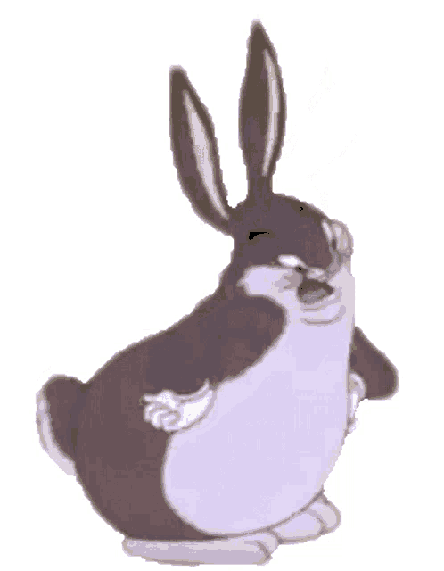

Can we do better?
RPE gives expected error at most 2k* in O(w Log(n/w)) probes
Coreset gives error at most (1+e)k* in O(w/e^2 Log(n/w) log n) probes
Are these the best we can do?
1 / 8
Notes:
So far in these lecture notes we have seen two algorithms for the monotone classification problem. The first one, RPE, which stands for Random Probe and Eliminate, gives us a classifier whose expected error is at most two times the optimal monotone error, k-star. And it does this using O of w times Log of n over w probes, where w is the dominance width of the partially ordered set. The second algorithm, which is based on relative-comparison coresets, goes further: for any epsilon you choose, it gives you a classifier with error at most one plus epsilon times k-star, and it uses O of w over epsilon squared times Log of n over w times log n probes. Now, both of these results are interesting, but they naturally raise the question: can we do better? Is there some smarter algorithm out there that could achieve the same accuracy with fewer probes? Or, maybe, could we get a tighter approximation ratio without paying more in terms of probes? This is exactly what this section of the paper addresses. The authors prove three lower bound results that essentially say no, you cannot do significantly better. These are not just arguments about specific algorithms. These are information-theoretic lower bounds, meaning they apply to every possible algorithm, no matter how clever. By the end of this section, we will see that RPE and the coreset algorithm are, up to small logarithmic factors, the best we can hope for. Let us start with the most extreme case.

Slide 102

Finding k* exactly is hopeless
Any algorithm that outputs the optimal classifier
must probe Ω(n) elements
even in 1D, even if k* is known in advance
2 / 8
Notes:
The first lower bound is Theorem 10, and it deals with the case where epsilon equals zero, meaning we want the exact optimal monotone classifier, not an approximation. The result says that any algorithm which outputs a classifier with error exactly equal to k-star, with probability greater than two-thirds, must probe at least omega of n elements in expectation. And this holds even in the simplest possible setting: one-dimensional data, and even if the algorithm is told the value of k-star upfront. Why is this significant? Well, if your dataset has n elements, probing omega of n elements is essentially the same as reading the entire dataset. So this theorem tells us that there is no shortcut. If you insist on exact optimality, you are forced to look at almost everything. This is a strong negative result. It means that the problem of finding the exact best monotone classifier is fundamentally different from the approximation version. No matter how smart your algorithm is, whether it is deterministic or randomized, adaptive or non-adaptive, it cannot avoid reading a constant fraction of the input. To prove this, the authors construct a specific family of hard inputs where the exact optimum is impossible to find without essentially inspecting every element. Let me show you what this family looks like.

Slide 103
How do we prove it?
Construct a hard input family — n/2 pairs, one anomaly hidden
…
…
+
+
−
+
−
−
−
−
normal
normal
anomaly
normal
→ algorithm must find the anomaly to be optimal
3 / 8
Notes:
The proof constructs what we call a hard input family. Here is how it works. Take n elements and group them into n over 2 consecutive pairs: pair one is elements one and two, pair two is elements three and four, and so on. In every normal pair, the odd-numbered element gets label plus one and the even-numbered element gets label minus one. Now, here is the twist. Exactly one of these pairs is an anomaly. In the anomaly pair, both elements get the same label, either both minus one or both plus one. So overall, we have n different possible inputs: n over 2 possible anomaly positions, each with two possible polarities. The key observation is that k-star equals n over 2 minus 1 for every single input in this family. Why? Because any monotone classifier on a totally ordered set is just a threshold: everything up to some point gets minus one, everything after gets plus one. And for every normal pair, one element will be misclassified no matter where you put the threshold. So the minimum error is exactly one per normal pair, except at the anomaly where you can get both right. But the optimal classifier is different depending on where the anomaly is and what its labels are. So the algorithm must figure out which pair is anomalous. And the only way to determine that is to probe elements in different pairs until you find the one that behaves differently. Since the anomaly could be anywhere, this requires searching through a linear number of pairs. That gives us the omega of n lower bound.

Slide 104

Yao’s minimax principle
Hard for every deterministic algorithm on average
→ hard for every randomized algorithm in the worst case
family-cost >= n^2(1-c^2)/4 → at least one input needs Omega(n) probes
4 / 8
Notes:
Now I should explain how the proof actually goes through formally, because what I just described gives the intuition, but we need to handle the fact that algorithms can be randomized. The formal proof uses a beautiful technique called Yao's minimax principle. The idea is this: instead of directly reasoning about randomized algorithms, which are hard to analyze because they make random choices, we instead reason about deterministic algorithms run against a randomly chosen input. Here is the argument. First, we give the algorithm a boost: when it probes either element of a pair, it learns both labels for free. This only makes the algorithm stronger, so any lower bound we prove in this model also applies to the original model. Now consider a deterministic algorithm that probes pairs in some fixed order. We use a counting argument, this is Lemma 11 in the paper. If the algorithm only probes t pairs, then for the n over 2 minus t pairs it never checked, it cannot distinguish between the two anomaly types. So it must get at least one of the two versions wrong for each unchecked pair. This gives us a lower bound on the total number of errors across the whole family. At the same time, we can compute the total probing cost across the family. Combining these two, we get that the total family cost, the sum of probes over all inputs, is at least n squared times one minus c squared over 4. Since there are n inputs in the family, at least one of them must require omega of n probes. Yao's principle then tells us: if every deterministic algorithm has high average cost on this distribution, then every randomized algorithm has high worst-case cost. And that completes the proof of Theorem 10.

Slide 105
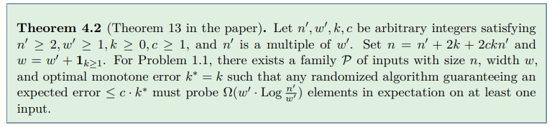
Even approximation is expensive
Any c-approximate algorithm needs
Omega(w * Log(n / k*w)) probes
→ RPE is essentially optimal for constant-factor approximation
5 / 8
Notes:
So the exact case requires omega of n probes. What if we relax our requirements and allow some approximation? Theorem 13 answers this for constant-factor approximation. The result says: for any constant c greater than or equal to 1, any algorithm that guarantees expected error at most c times k-star must use at least omega of w-prime times Log of n-prime over w-prime probes on some input of width w and optimal error k-star. The proof uses a clever reduction to the realizable case. The idea is to take a hard family where k-star equals zero, the realizable setting, and then add so-called dummy points to artificially create a nonzero k-star. These dummy points are carefully placed so that each real point is surrounded by c times k dummy points that have the same correct label. Why does this work? Because if the algorithm misclassifies even one real point, the c-k surrounding dummies will also be misclassified, giving a total error of at least c times k plus 1. Since the algorithm promises error at most c times k-star equals c times k, it cannot afford to get any real point wrong. This means the algorithm is forced to correctly classify every real point, which is exactly the realizable problem on the original points. And we already know from a prior result that the realizable problem requires omega of w times Log of n over w probes. So the algorithm inherits that lower bound. The bottom line is that RPE, which achieves O of w times Log of n over w probes, is essentially optimal for constant-factor approximation. You cannot beat it by more than a small factor depending on k-star.

Slide 106
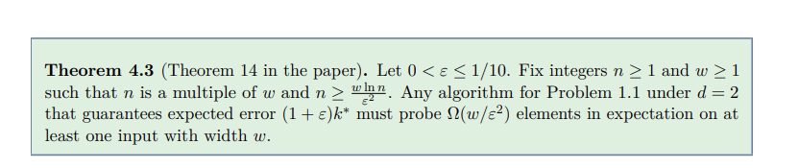
The 1/e^2 barrier
Any (1+e)-approximate algorithm needs
Omega(w / e^2) probes
→ like telling apart two biased coins — you need Theta(1/e^2) flips
6 / 8
Notes:
Now we come to the most important lower bound: Theorem 14. This one deals with arbitrary epsilon, and it says that any algorithm guaranteeing expected error at most one plus epsilon times k-star must use at least omega of w over epsilon squared probes. This holds even for two-dimensional data. This is a very strong result because it tells us that the one over epsilon squared dependence in the coreset algorithm is not an artifact of the algorithm's design. It is a fundamental barrier. No algorithm can avoid it. The hard input construction is different from the previous ones. Here we place n over w points at each of w pairwise incomparable locations. Think of these locations as forming an antichain, no location dominates any other. Then each location independently gets a random bias: either mu-1 which equals one half minus gamma over 2, or mu-2 which equals one half plus gamma over 2, where gamma is about 9 epsilon. Each point at a location gets label plus one with probability equal to that location's bias, independently. The crux of the difficulty is a coin-distinguishing problem. At each location, the algorithm sees a sequence of random labels, some plus one, some minus one. The distribution of these labels is either slightly biased toward minus one or slightly biased toward plus one. The difference between the two biases is tiny, it is proportional to epsilon. And the classical result from statistics, related to Le Cam's method, says that you need theta of one over epsilon squared samples to reliably tell these two distributions apart. Since the algorithm must figure out the bias at each of the w locations to classify correctly, it needs at least omega of w over epsilon squared probes in total.

Slide 107
Why Omega(w/e^2)?
Each location is a biased coin — flip it enough to tell which side it favours
½ − ε
vs
½ + ε
slightly more −1
slightly more +1
→ need Theta(1/e^2) samples per location × w locations = Omega(w/e^2)
7 / 8
Notes:
Let me give you the intuition for why the proof works, because I think this is the most elegant part. Imagine you have a coin, and you want to figure out whether it lands heads with probability one half minus epsilon, or one half plus epsilon. These two coins are very similar. The difference in their bias is only 2 epsilon. If you only flip the coin a few times, you will see roughly the same mix of heads and tails either way. It is only when you flip it many times, specifically on the order of one over epsilon squared times, that the law of large numbers kicks in and you can reliably tell the two coins apart. This is a classical result in statistics. It follows from what is known as Le Cam's method, or in the context of this paper, the Anthony-Bartlett distinguishing lemma. The authors formalize this by defining two random processes: RP-1, where all labels are generated upfront, and RP-2, where labels are generated on demand as the algorithm probes. They prove that these two processes are equivalent in terms of the expected approximation ratio, this is Lemma 15. The advantage of RP-2 is that we can track exactly how many times the algorithm probes each location. If the total probe budget is less than w times M over 8, where M is theta of one over epsilon squared, then by a simple averaging argument, more than half the locations have been probed fewer than M times. At these under-probed or light locations, Lemma 19 shows the algorithm guesses the bias wrong with probability greater than one quarter. Each wrong guess contributes a certain amount of excess error. Summing over all the light locations, the expected approximation ratio exceeds one plus epsilon, violating the algorithm's guarantee. This contradiction proves that the algorithm must use at least omega of w over epsilon squared probes.

Slide 108
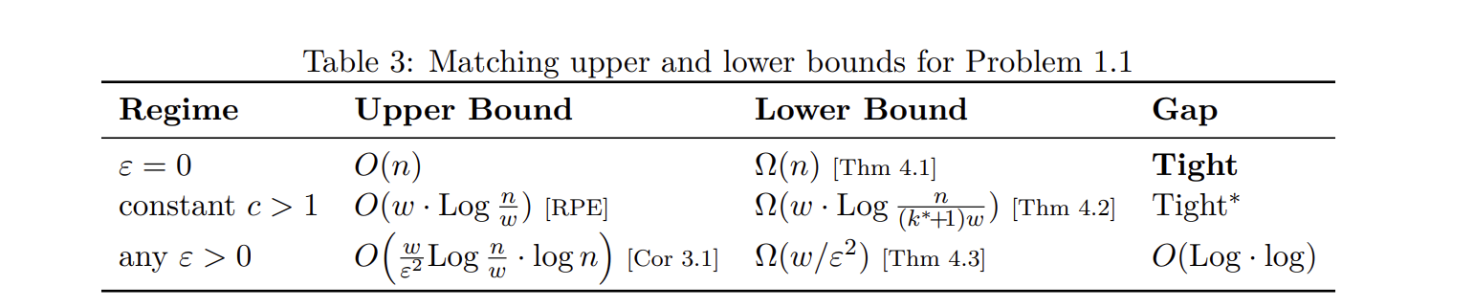
The full picture
8 / 8
Notes:
Let me now put everything together. This table summarizes the three regimes and how the upper and lower bounds compare. In the first regime, epsilon equals zero, we want the exact optimum. The upper bound is trivially O of n because you can just read everything. And Theorem 10 says the lower bound is omega of n. So these are tight. Finding the exact optimum is genuinely as hard as reading the entire input. In the second regime, we allow a constant approximation factor c. The RPE algorithm gives an upper bound of O of w times Log of n over w. Theorem 13 gives a lower bound of omega of w times Log of n over k-star-w. When k-star is not too large, specifically when k-star is at most n over w to the power one minus delta for some small delta, these two bounds match. So RPE is optimal for constant-factor approximation in the typical case. In the third regime, we want a one-plus-epsilon approximation for any epsilon. The coreset algorithm achieves O of w over epsilon squared times Log of n over w times log n probes. Theorem 14 gives a lower bound of omega of w over epsilon squared. So there is a gap, but it is only polylogarithmic, just some Log and log n factors. The conclusion is remarkable: our algorithms are near-optimal. The dominant terms, w in the cost, one over epsilon squared in the sampling, are all necessary. The only remaining open question is whether the polylogarithmic gap can be closed, either by improving the upper bound or by strengthening the lower bound. But the core complexity of the monotone classification problem is now fully understood: it is theta of w over epsilon squared, up to polylogarithmic factors. And that is a very satisfying conclusion.

Slide 109
Thank you!

